Slide 1

Enabling Efficient and Scalable DRAM Read Disturbance Mitigation via New Experimental Insights into Modern DRAM Chips
Abdullah Giray Yağlıkçı
Aug 12, 2024
SK Hynix

Slide 2

Brief Self Introduction
Abdullah Giray Yaglikci
Researcher @ SAFARI Research Group since August 2016
ETH Zurich (Feb 2018 – ongoing)
Intel Labs (Aug 2017 – Feb 2018)
Carnegie Mellon University (Aug 2016 – Aug 2017)
Defended my PhD thesis, advised by Onur Mutlu, in April 2024
https://agyaglikci.github.io/
agirayyaglikci@gmail.com (Best way to reach me)
https://safari.ethz.ch
Research interests:
Computer architecture, hardware security
Memory and storage systems
Hardware security, safety, reliability, performance, availability, fairness, energy efficiency
Hardware/software cooperation
…

Slide 3
Papers in This Talk
Lois Orosa, Abdullah Giray Yaglikci, Haocong Luo, Ataberk Olgun, Jisung Park, Hasan Hassan, Minesh Patel, Jeremie S. Kim, and Onur Mutlu, "A Deeper Look into RowHammer’s Sensitivities: Experimental Analysis of Real DRAM Chips and Implications on Future Attacks and Defenses” in MICRO, 2021. [Slides (pptx) (pdf)] [Short Talk Slides (pptx) (pdf)] [Lightning Talk Slides (pptx) (pdf)] [Talk Video (21 mins)] [Lightning Talk]
A. Giray Yağlıkçı, Haocong Luo, Geraldo F. de Oliviera, Ataberk Olgun, Minesh Patel, Jisung Park, Hasan Hassan, Jeremie S. Kim, Lois Orosa, and Onur Mutlu, "Understanding RowHammer Under Reduced Wordline Voltage: An Experimental Study Using Real DRAM Devices” in DSN, 2022. [Slides (pptx) (pdf)] [Lightning Talk Slides (pptx) (pdf)] [arXiv version] [Talk Video (34 mins)] [Lightning Talk Video (2 mins)]
Abdullah Giray Yaglikci, Geraldo Francisco de Oliveira, Yahya Can Tugrul, Ismail Yuksel, Ataberk Olgun, Haocong Luo, and Onur Mutlu, "Spatial Variation-Aware Read Disturbance Defenses: Experimental Analysis of Real DRAM Chips and Implications on Future Solutions” in HPCA, 2024. [Slides (pptx) (pdf)] [arXiv version]
A. Giray Yaglıkcı, Ataberk Olgun, Minesh Patel, Haocong Luo, Hasan Hassan, Lois Orosa, Oguz Ergin, and Onur Mutlu, "HiRA: Hidden Row Activation for Reducing Refresh Latency of Off-the-Shelf DRAM Chips” in MICRO, 2022. [Slides (pptx) (pdf)][Longer Lecture Slides (pptx) (pdf)] [Lecture Video (36 minutes)]
A. Giray Yaglikci, Minesh Patel, Jeremie S. Kim, Roknoddin Azizi, Ataberk Olgun, Lois Orosa, Hasan Hassan, Jisung Park, Konstantinos Kanellopoulos, Taha Shahroodi, Saugata Ghose, and Onur Mutlu, "BlockHammer: Preventing RowHammer at Low Cost by Blacklisting Rapidly-Accessed DRAM Rows,” in HPCA, 2021. [Slides (pptx) (pdf)] [Short Talk Slides (pptx) (pdf)] [Talk Video (22 minutes)] [Short Talk Video (7 minutes)] [Intel Hardware Security Academic Awards Short Talk Slides (pptx) (pdf)] [Intel Hardware Security Academic Awards Short Talk Video (2 minutes)] [BlockHammer Source Code] Intel Hardware Security Academic Award Finalist (one of 4 finalists out of 34 nominations)
Oğuzhan Canpolat, A. Giray Yağlıkçı, Geraldo F. Oliveira, Ataberk Olgun, Oğuz Ergin, and Onur Mutlu, "Understanding the Security Benefits and Overheads of Emerging Industry Solutions to DRAM Read Disturbance” DRAMSec, held with ISCA, 2024. [Slides (pptx) (pdf)] [arXiv version] [Source Code]
Oğuzhan Canpolat and A. Giray Yağlıkçı and Ataberk Olgun and İsmail Emir Yüksel and Yahya Can Tuğrul and Konstantinos Kanellopoulos and Oğuz Ergin and Onur Mutlu “Leveraging Adversarial Detection to Enable Scalable and Low Overhead RowHammer Mitigations,” arXiv [cs.CR 2404.13477], 2024.

Slide 4
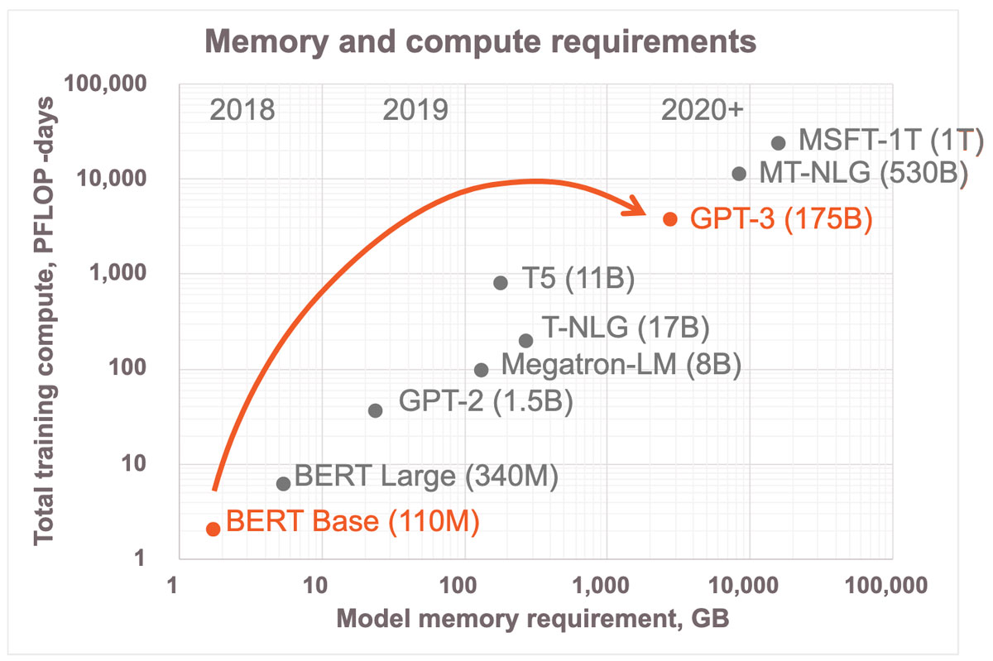
Memory & Generative AI (I)
Image Source: https://www.cerebras.net/blog/cerebras-architecture-deep-dive-first-look-inside-the-hw/sw-co-design-for-deep-learning

Slide 5
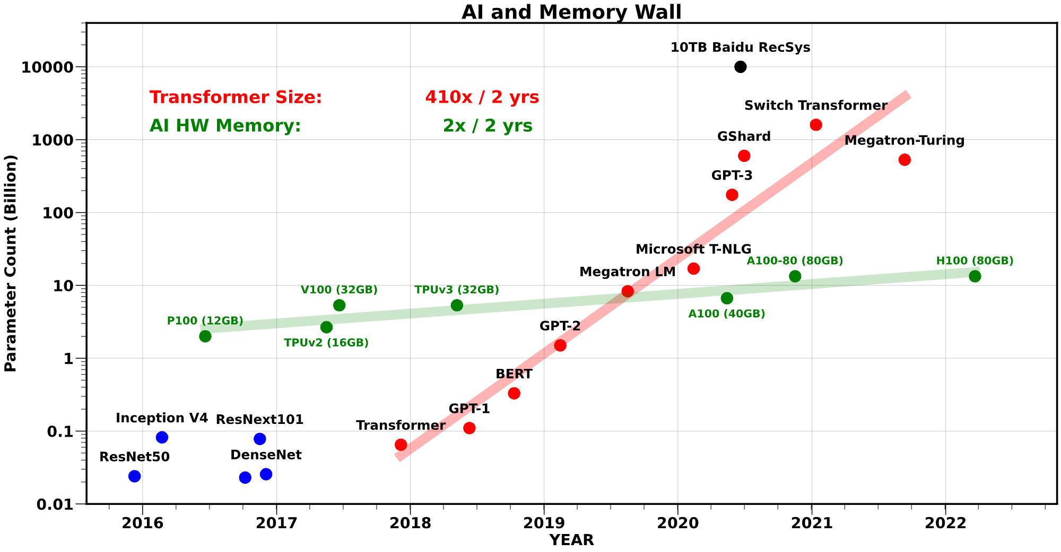
Memory & Generative AI (II)
Increasing gap
Gholami A, Yao Z, Kim S, Mahoney MW, Keutzer K. AI and Memory Wall. RiseLab Medium Blog Post, University of Califonia Berkeley, 2021, March 29.

Slide 6

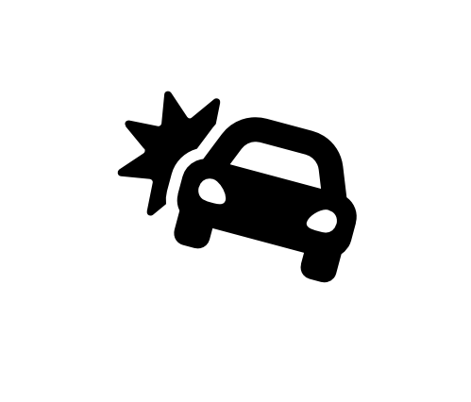


Memory Isolation
A memory access should not have unintended side effects on data stored in other addresses
A fundamental property for robustness (safety, security, and reliability)
Data loss or corruption
access
Compromise application correctness
1 → 0
Leak private information
Take over a computer
Memory
Memory isolation is difficult in modern memory chips
Notes:
Let’s start with the concept of memory isolation, a fundamental primitive for system security and privacy [CLICK]
Imagine that you access a memory location, and a bitflip occurs in some other location [CLICK]
We would not want this to happen because it can lead to data loss or corruption [CLICK]
Compromise application correctness [CLICK]
It can be used to leak private information [CLICK]
Or even to take over a computer [CLICK]
Therefore, we have this principle called memory isolation dictating that a memory access should not have unintended side effects on data stored in other addresses. This is important for memory integrity [CLICK]
Unfortunately, it is difficult in modern memory chips and here is why [CLICK]

Slide 7
Read Disturbance in Modern Memory Chips
Prevalent memory technology: Dynamic Random Access Memory (DRAM)
DRAM stores data in the form of electrical charge on a capacitor
DRAM leaks charge over time and needs periodic refresh
DRAM Read Disturbance: Accessing a DRAM cell disturbs other physically nearby cells and exacerbates their charge leakage
Wordline
Bitline
Charge
leakage
paths
Notes:
Dynamic random access memory (DRAM) is the prevalent memory technology today. [CLICK]
DRAM stores a bit of data in the form of electrical charge on a capacitor [CLICK]
To access we assert a wire called wordline [CLICK]
Which enables a transistor, conducting the capacitor to another wire called bitline [CLICK]
DRAM is a volatile memory technology as it leaks charge over time and needs to be periodically refreshed [CLICK]
Accessing a DRAM cell disturbs other physically nearby cells and exacerbates their charge leakage. This is called DRAM read disturbance [CLICK]

Slide 8
RowHammer: An Example of DRAM Read Disturbance
DRAM Subarray
Row 0
Row 1
Row 1
Victim Row
Row 2
Row 2
Row 2
Row 2
Row 2
Row 2
open
open
open
closed
closed
Aggressor Row
Aggressor Row
Row 3
Row 3
Row 2
Victim Row
closed
Row 4
Repeatedly opening (activating) and closing (precharging)
a DRAM row causes RowHammer bitflips in nearby cells
and breaks memory isolation
Notes:
A prime example of DRAM read disturbance is RowHammer, which I will show in this slide.
DRAM cells are organized in 2 dimensional arrays as rows and columns and internally accessed in a DRAM row granularity. For example, to access a data stored in Row 2, [CLICK]
We first need to open Row 2, and then perform accesses. Once we need to access another row, we need to close Row 2 and open the other row [CLICK]
[BACK& FORTH] If we keep opening and closing this row many times, called hammering a row, [CLICK]
We observe bitflips in physically nearby DRAM rows [CLICK]
This phenomenon is called RowHammer. We refer to the hammered row as the aggressor row and the rows that are affected as victim rows. [CLICK]

Slide 9
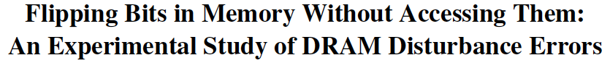
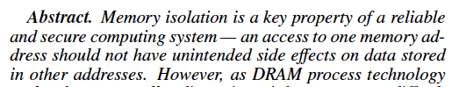
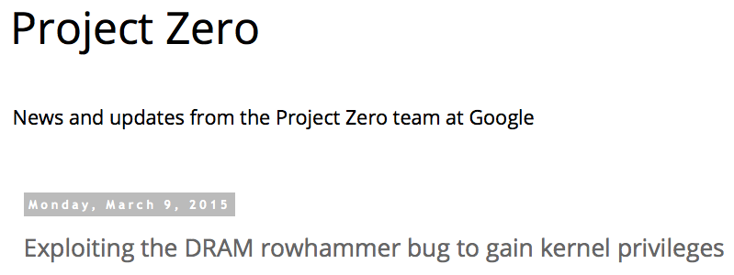
One Can Take Over an Otherwise-Secure System
Flipping Bits in Memory Without Accessing Them: An Experimental Study of DRAM Disturbance Errors (Kim et al., ISCA 2014)
Exploiting the DRAM rowhammer bug to gain kernel privileges (Seaborn, 2015)
Induce bit flips in page table entries (PTEs).
Gain write access to its own page table, and hence gain read-write access to all of physical memory.

Slide 10
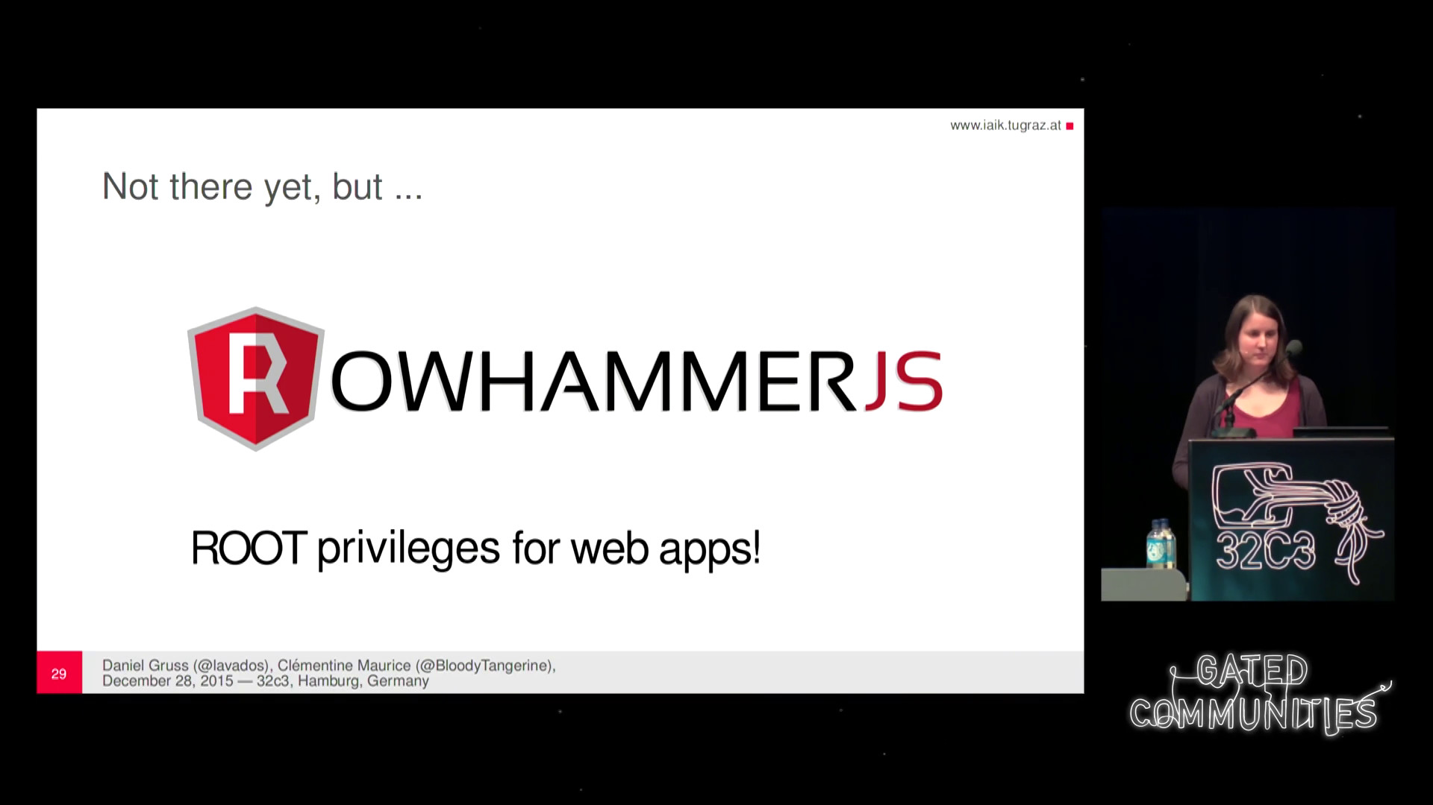
More Security Implications (I)
“We can gain unrestricted access to systems of website visitors.”
Rowhammer.js: A Remote Software-Induced Fault Attack in JavaScript (DIMVA’16)
Source: https://lab.dsst.io/32c3-slides/7197.html

Slide 11

More Security Implications (II)
“Can gain control of a smart phone deterministically”
Drammer: Deterministic Rowhammer Attacks on Mobile Platforms, CCS’16
Source: https://fossbytes.com/drammer-rowhammer-attack-android-root-devices/

Slide 12
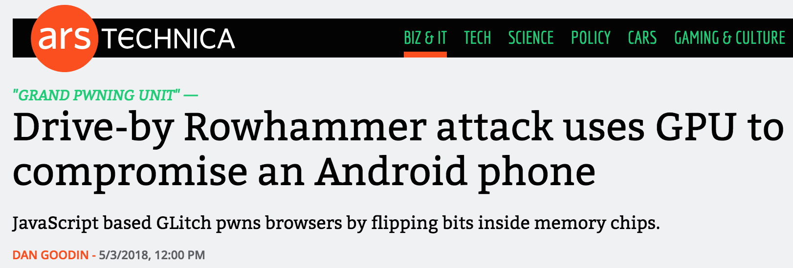

More Security Implications (III)
Using an integrated GPU in a mobile system to remotely escalate privilege via the WebGL interface. IEEE S&P 2018

Slide 13
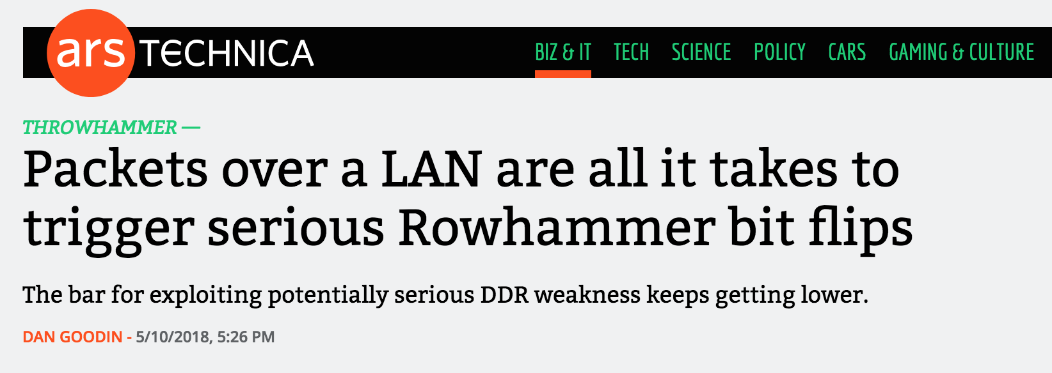
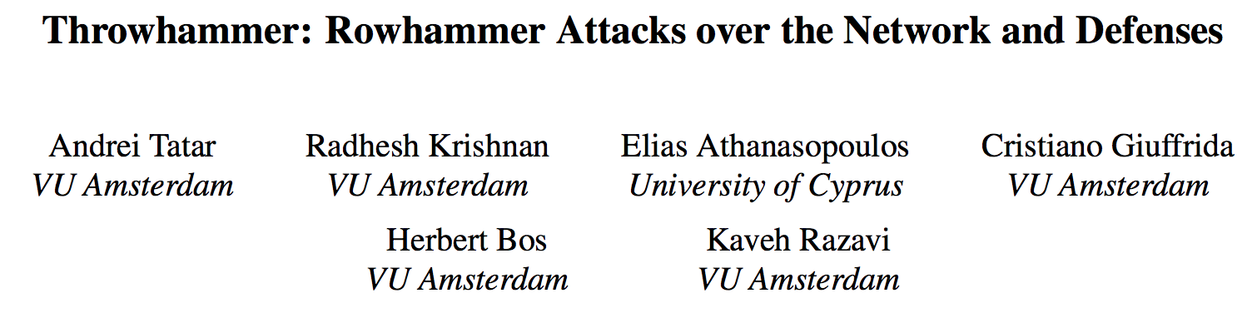
More Security Implications (IV)
Rowhammer over RDMA (I)
[Tatar+ USENIX ATC, 2018]

Slide 14


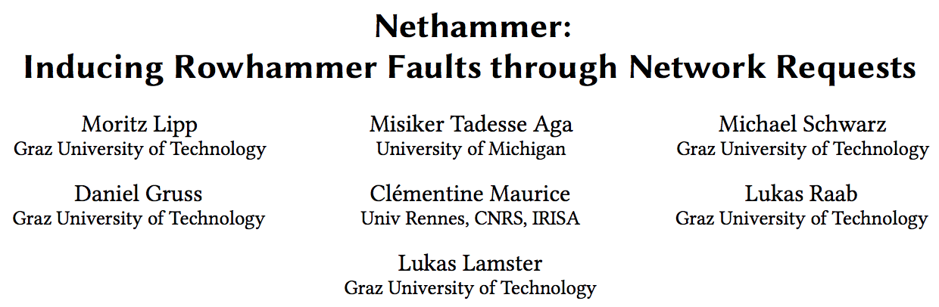
More Security Implications (V)
Rowhammer over RDMA (II)
[Lipp+ EuroS&PW, 2020]

Slide 15
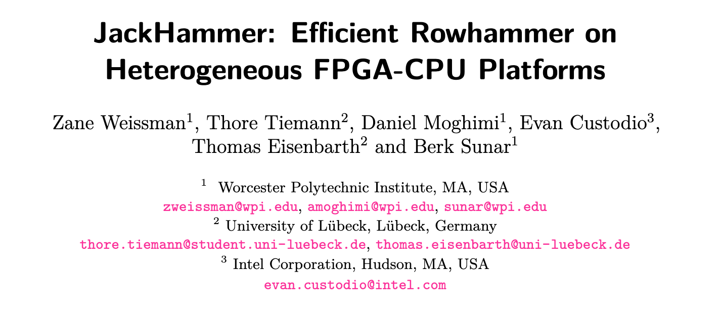
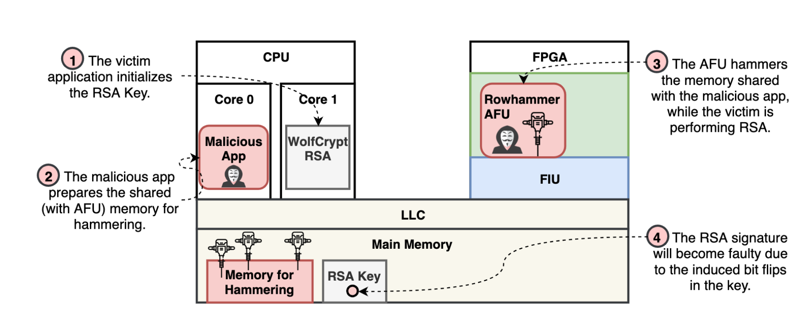
More Security Implications (VI)
An FPGA-based RowHammer attack recovering private keys twice as fast compared to CPU-based attacks
[Weissman+ CHES 2020]

Slide 16

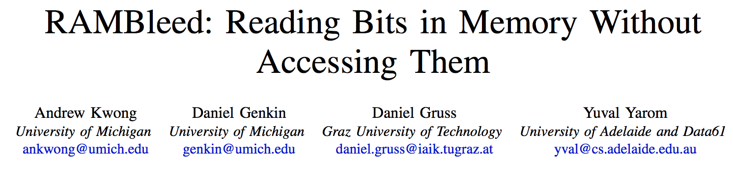
More Security Implications (VII)
[Kwong+ IEEE S&P 2020]

Slide 17
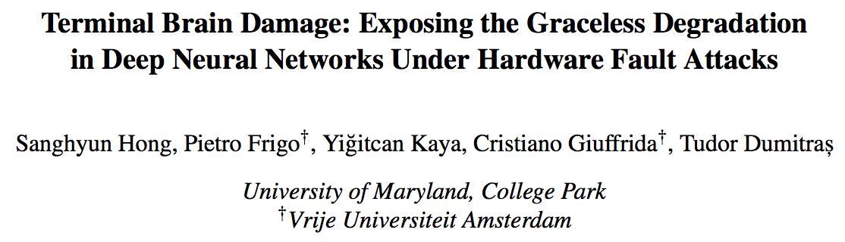
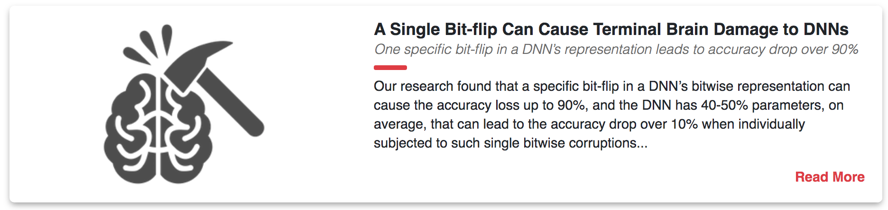
More Security Implications (VIII)
[Hong+ USENIX Security 2019]

Slide 18
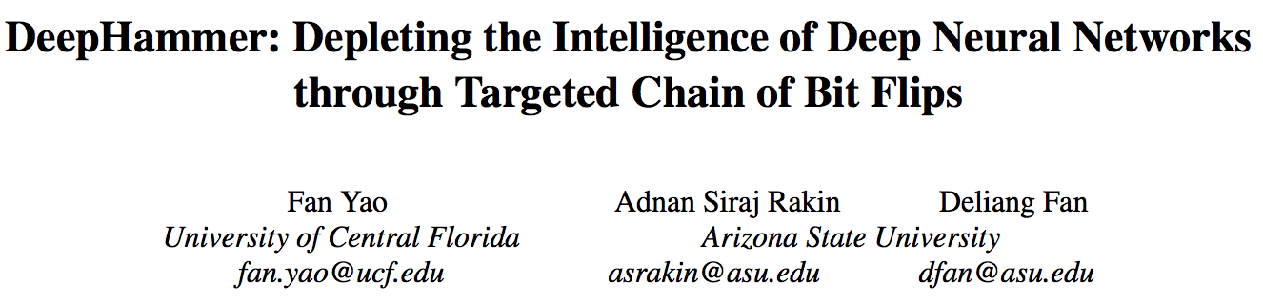
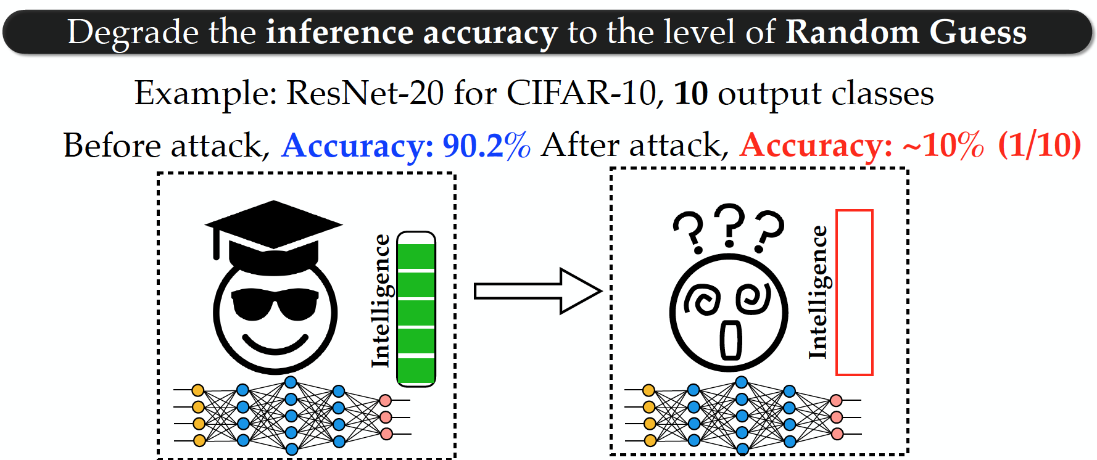
More Security Implications (IX)
[Yao+ USENIX Security 2020]

Slide 19
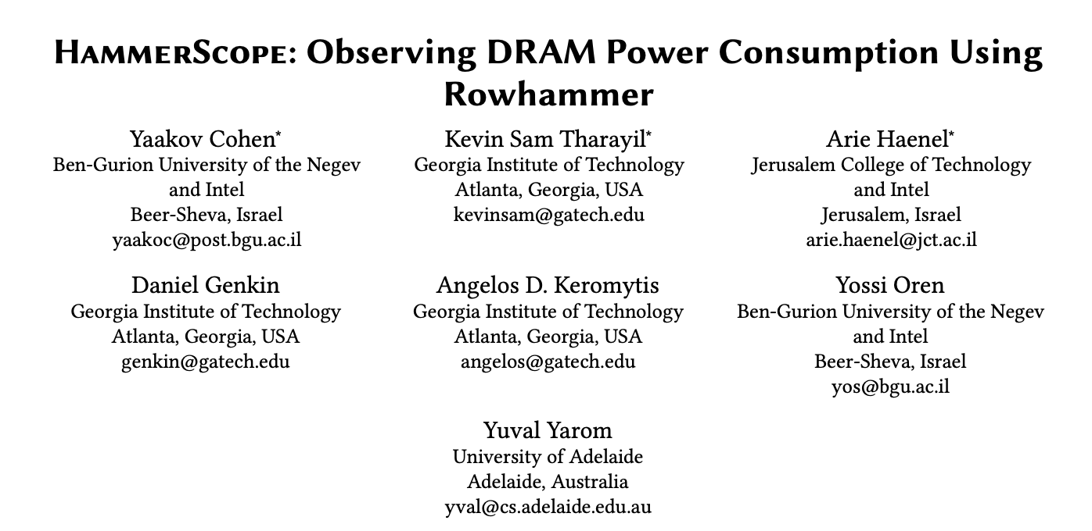
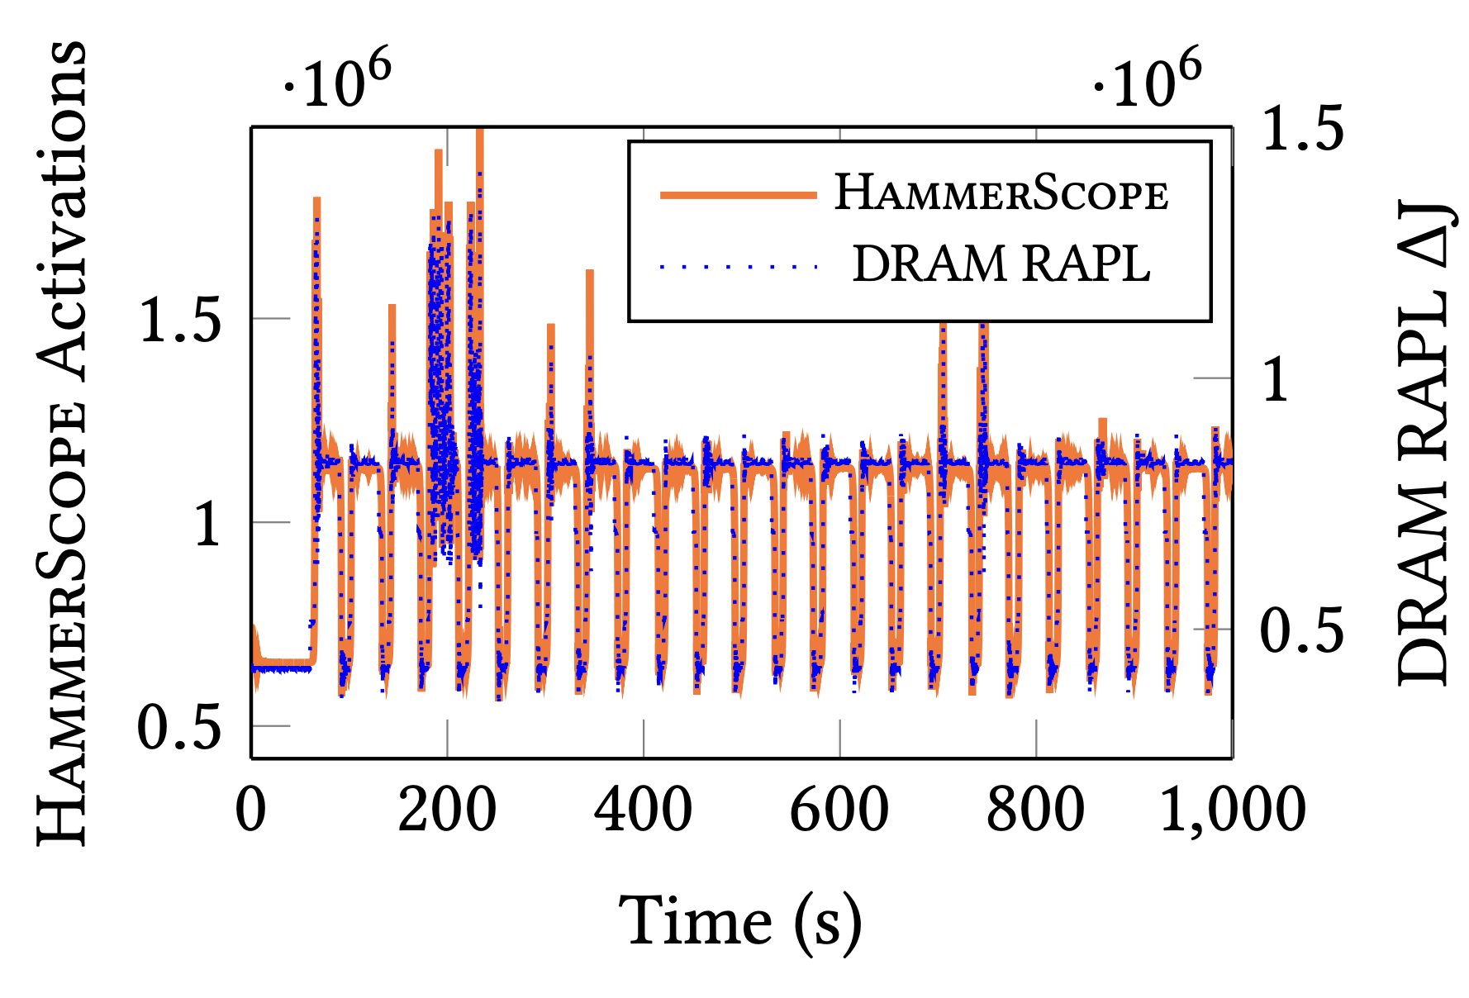
More Security Implications (X)
HammerScope is a software-based power analysis method using RowHammer as a side channel
[Cohen+ CCS 2022]

Slide 20
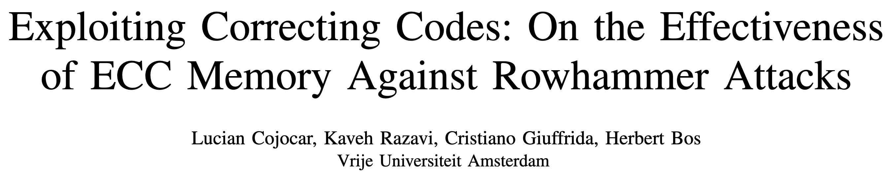
More Security Implications (XI)
Exploiting Correcting Codes: On the Effectiveness of ECC Memory Against Rowhammer Attacks. Cojocar, L. .; Razavi, K.; Giuffrida, C.; and Bos, H. In S&P, May 2019 Best Practical Paper Award, Pwnie Award Nomination for Most Innovative Research [Paper] [Slides]
Thus, many believed that Rowhammer on ECC memory, even if plausible in theory, is simply impractical. This paper shows this to be false: while harder, Rowhammer attacks are still a realistic threat even to modern ECC-equipped systems.

Slide 21
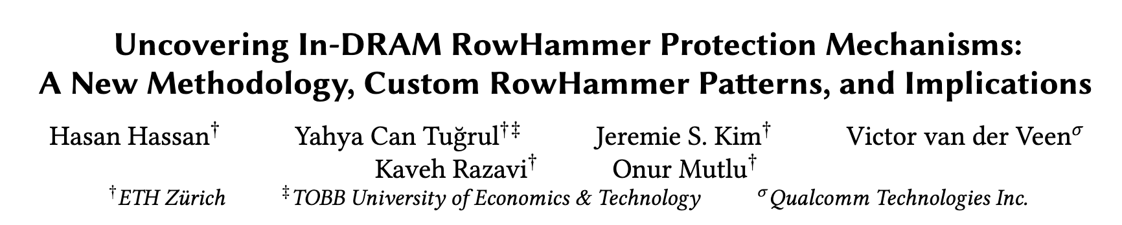





More Security Implications (XII)
Hasan Hassan, Yahya Can Tugrul, Jeremie S. Kim, Victor van der Veen, Kaveh Razavi, and Onur Mutlu, "Uncovering In-DRAM RowHammer Protection Mechanisms: A New Methodology, Custom RowHammer Patterns, and Implications,” MICRO, 2021. [Slides (pptx) (pdf)] [Short Talk Slides (pptx) (pdf)] [Lightning Talk Slides (pptx) (pdf)] [Full Talk (25 mins)] [Lightning Talk (1.5 mins)]
15x Vendor A DDR4 modules
All 45 modules we test are vulnerable
15x Vendor B DDR4 modules
99.9% of rows in a DRAM bank experience at least one RowHammer bit flip
New RowHammer access patterns
15x Vendor C DDR4 modules
U-TRR
Up to 7 RowHammer bitflips in an 8-byte dataword, making ECC ineffective
TRR does not provide security against RowHammer
U-TRR can facilitate the development of new RowHammer attacks and more secure RowHammer protection mechanisms
Notes:
[CLICK] The RowHammer vulnerability of modern DRAM is a critical reliability and security threat.
[CLICK] The security guarantees of TRR, which is the commonly used RowHammer protection mechanism, cannot be easily studied as TRR is obscure, undocumented, and proprietary.
[CLICK] In this work, our main goal is to answer the following questions. Is TRR fully secure? How can we validate the security guarantees of different TRR mechanisms?
[CLICK] To this end, we propose U-TRR, a new methodology that leverages data retention failures in DRAM to uncover the inner workings of TRR and study its security.
[CLICK] Using U-TRR, we analyze 15 DDR4 DRAM modules from each of the three major DRAM vendors.
[CLICK] Through these analyses, we make several observations regarding the TRR mechanisms implemented in these modules and craft new custom RowHammer access patterns that cause RowHammer bit flips in TRR-protected DRAM modules.
[CLICK] Our results show that: First, all 45 modules that we test across three vendors are vulnerable to our new RowHammer access patterns.
[CLICK] Second, our access pattern cause at least one bit flip in almost all DRAM rows in many modules. This makes system-level RowHammer attacks easier to mount as the attacker would have the ability to cause bit flips in almost any DRAM row [CLICK] Third, we observe that our access patterns cause up to 7 RowHammer bit flips in an 8-byte dataword, making ECC ineffective and systems equipped with ECC also susceptible to RowHammer attacks
[CLICK] We conclude that TRR does not provide security against RowHammer and can be easily circumvented using the new understanding provided by U-TRR.
[CLICK] We believe and hope that U-TRR will facilitate future research by enabling rigorous and open analysis of RowHammer mitigation mechanisms, leading to the development of both new RowHammer attacks and more secure RowHammer protection mechanisms.

Slide 22

A RowHammer Survey:
Onur Mutlu, Ataberk Olgun, and A. Giray Yaglikci, "Fundamentally Understanding and Solving RowHammer” Invited Special Session Paper at the 28th Asia and South Pacific Design Automation Conference (ASP-DAC), Tokyo, Japan, January 2023. [arXiv version] [Slides (pptx) (pdf)] [Talk Video (26 minutes)]
https://arxiv.org/pdf/2211.07613.pdf

Slide 23
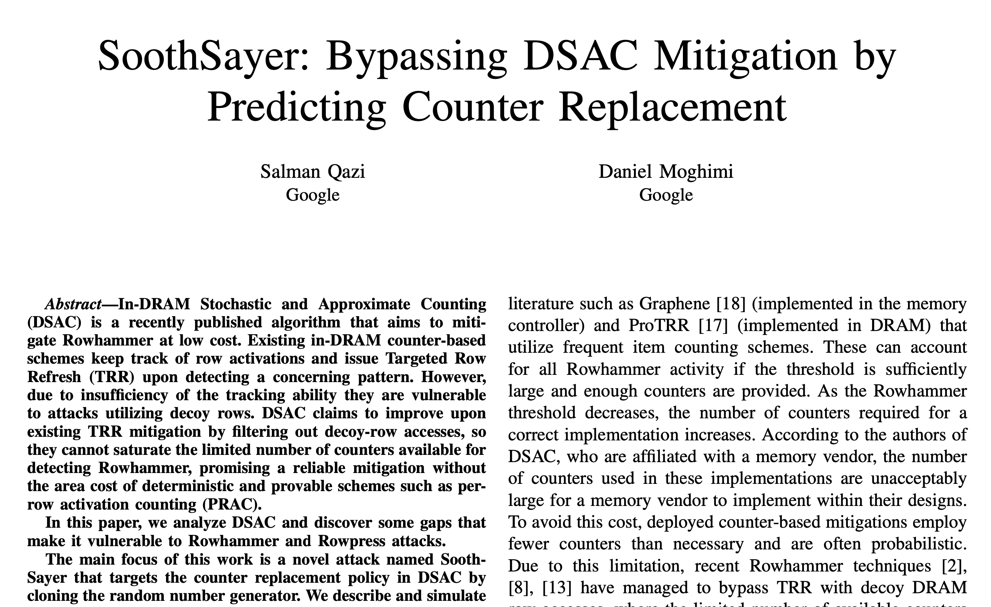
Breaking Samsung’s Best Practice in 2024
Salman Qazi and Daniel Moghimi, “SoothSayer: Bypassing DSAC Mitigation by Predicting Counter Replacement,” DRAMSec, 2024

Slide 24
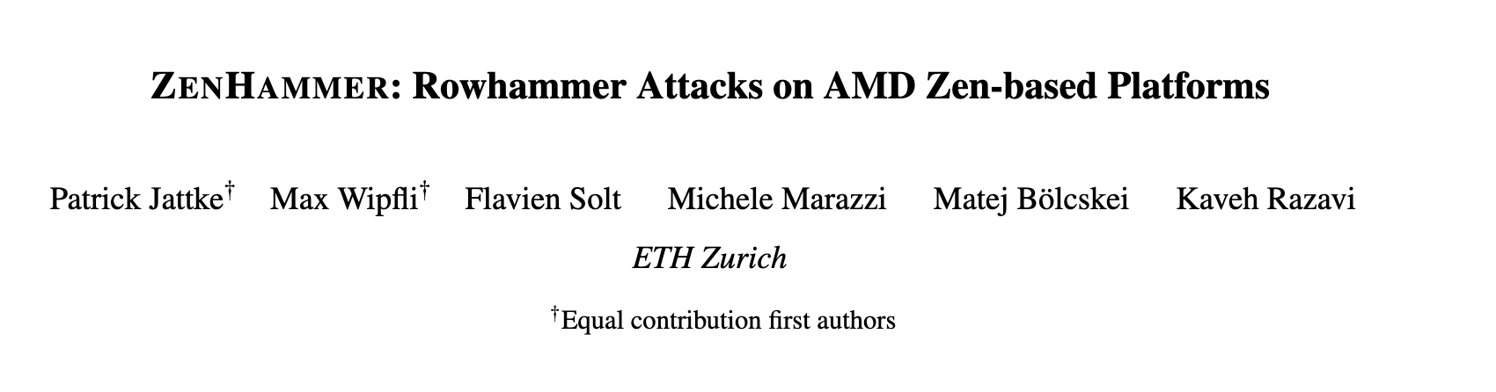
RowHammer in DDR5
Patrick Jattke; Max Wipfli; Flavien Solt; Michele Marazzi; Matej Bölcskei; and Kaveh Razavi, “ZenHammer: Rowhammer Attacks on AMD Zen-based Platforms,” in USENIX Security, 2024. [Paper] [URL]
We found bit flips on only 1 of 10 tested devices (S1), suggesting that the changes in DDR5 such as improved Rowhammer mitigations, on-die error correction code (ECC), and a higher refresh rate (32 ms) make it harder to trigger bit flips.

Slide 25
DRAM Read Disturbance: A Critical Challenge
Technology node scaling
[Kim+, ISCA’14]
[Kim+, ISCA’20]
[Luo+, ISCA’23]
DRAM cells become increasingly more vulnerable to read disturbance
Notes:
With technology node scaling, DRAM cells get smaller in size and closer to each other[CLICK]
Such that we observe significant reductions in the minimum hammer count to induce the first bitflip in the last decade [CLICK]
Thus DRAM cells become increasingly more vulnerable to read disturbance [CLICK]

Slide 26
Existing RowHammer Mitigations (I)
DRAM Subarray
Row 0
Row 0
Row 0
Victim Row
Row 1
Row 1
Row 1
Row 1
Victim Row
Row 2
Row 2
Row 2
Row 2
Row 2
Row 2
open
open
open
closed
Aggressor Row
Aggressor Row
Row 3
Row 3
Row 3
Row 3
Victim Row
Row 4
Row 4
Row 4
Victim Row
Refreshing potential victim rows mitigates read disturbance bitflips

Slide 27

Existing RowHammer Mitigations (II)
DRAM Subarray
Row 0
Row 0
Row 0
Victim Row
Row 1
Row 1
Row 1
Row 1
Victim Row
Row 2
Row 2
Row 2
Row 2
Row 2
Row 2
open
open
open
closed
Aggressor Row
Aggressor Row
Row 3
Row 3
Row 3
Row 3
Victim Row
Row 4
Row 4
Row 4
Victim Row
Mitigation techniques track DRAM row activation counts (of aggressor rows) to preventively refresh potential victim rows

Slide 28
Two Key Challenges
Scalability
with worsening read disturbance vulnerability
1
Compatibility
with commodity DRAM chips
Compatibility
with commodity DRAM chips
2
Compatibility
with commodity DRAM chips
2
2
Notes:
Unfortunately, existing mechanisms face two key challenges.
[CLICK] Let's begin with the scalability challenge.

Slide 29
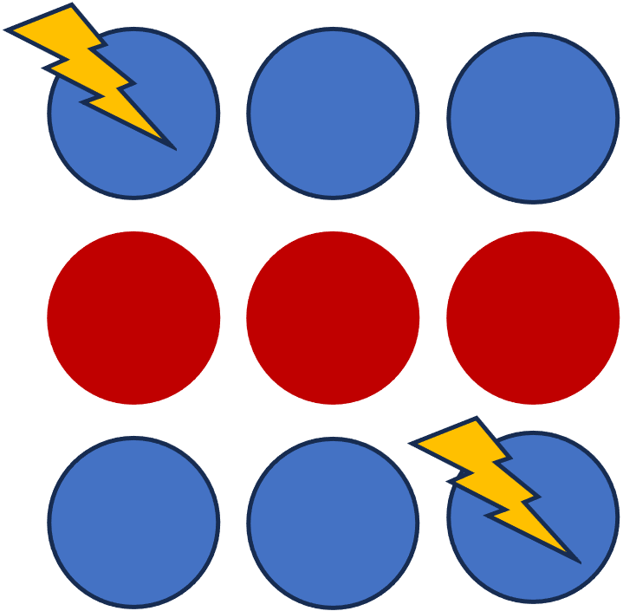
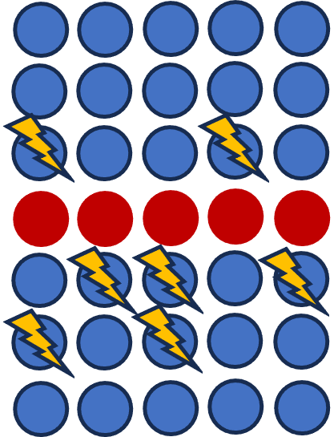
Challenge (1/2): Scalability
DRAM cells become
increasingly more vulnerable
to read disturbance at device level
Existing solutions become prohibitively expensive or ineffective going forward [Kim+, ISCA’20] [Frigo+, IEEE S&P’20] [Hassan+, MICRO’21]
We need more efficient and scalable solutions to DRAM read disturbance
A more detailed understanding of DRAM read disturbance can help
Notes:
My thesis identifies two problems about solving DRAM read disturbance [CLICK]
First, As DRAM cells become more vulnerable, [CLICK]
Existing solutions become prohibitively expensive or ineffective going forward [CLICK]
Thus, we need more efficient and scalable solutions [CLICK]
And we believe that a more detailed understanding of DRAM read disturbance can help us to achieve it[CLICK]

Slide 30
Challenge (2/2): Compatibility
Application
Level
In-DRAM Mapping
Virtual Memory Address
Proprietary
Processor-visible
Row Addresses
System
Level
Physical Memory Address
Memory
Controller
DRAM Bus Addresses
(Channel, Rank, Bank, Row…)
Physical Row Addresses
Visible within the processor
DRAM chip
A RowHammer attack hammers Row A
Processor-based defenses can detect the attack
Refresh rows A+1 and A-1
Bitflips still may occur due to unknown DRAM-internal row mapping
Victim
Rows
Row A
Row A-1
Row A+1
Physical Row Layout
Many existing solutions rely on this proprietary information
Notes:
The second problem is about compatibility with DRAM communication protocols [CLICK]
Let’s recap how we manage memory addresses. We use virtual addresses in the application level [CLICK]
The system software translates them to physical addresses [CLICK]
Which then parsed in the memory controller to identify DRAM bus addresses, such as banks and rows [CLICK]
All these translations are visible within the processor [CLICK]
However, yet another translation is performed within the DRAM chips from processor-visible addresses to physical row addresses [CLICK]
This translation is proprietary information of the DRAM vendors and obfuscated from the processor [CLICK]
When a RowHammer attack hammers a Row A [CLICK]
A defense implemented in the processor can detect this attack [CLICK]
And preventively refresh row addresses A+1 and A-1, which may not correspond to actual victim rows [CLICK]
As a result, bitflips still may occur [CLICK]
Unfortunately, many existing solutions rely on this proprietary information [CLICK]

Slide 31


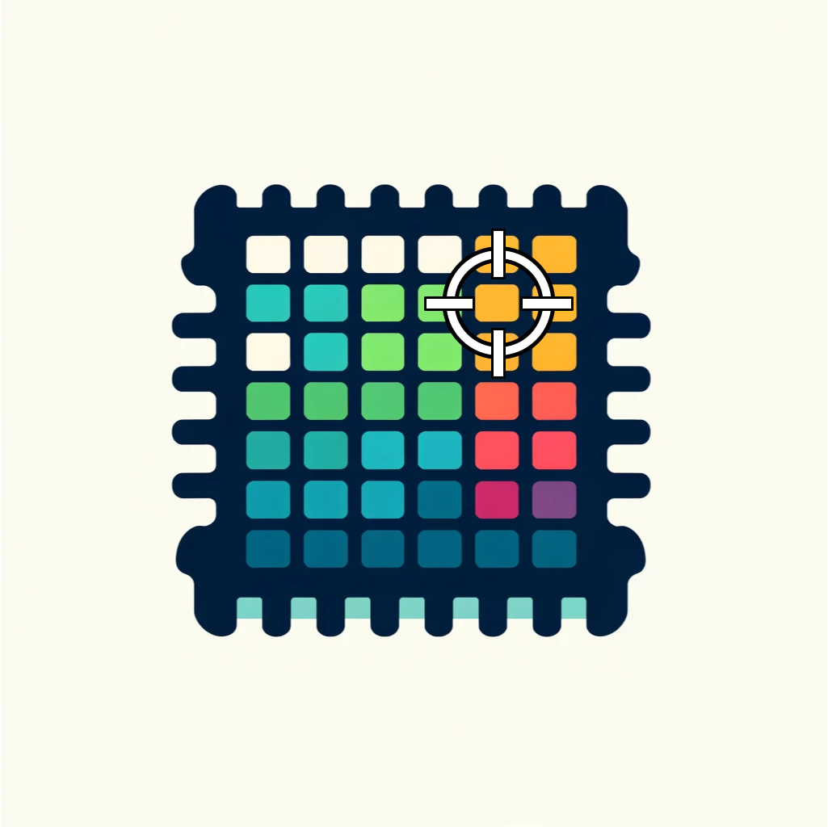
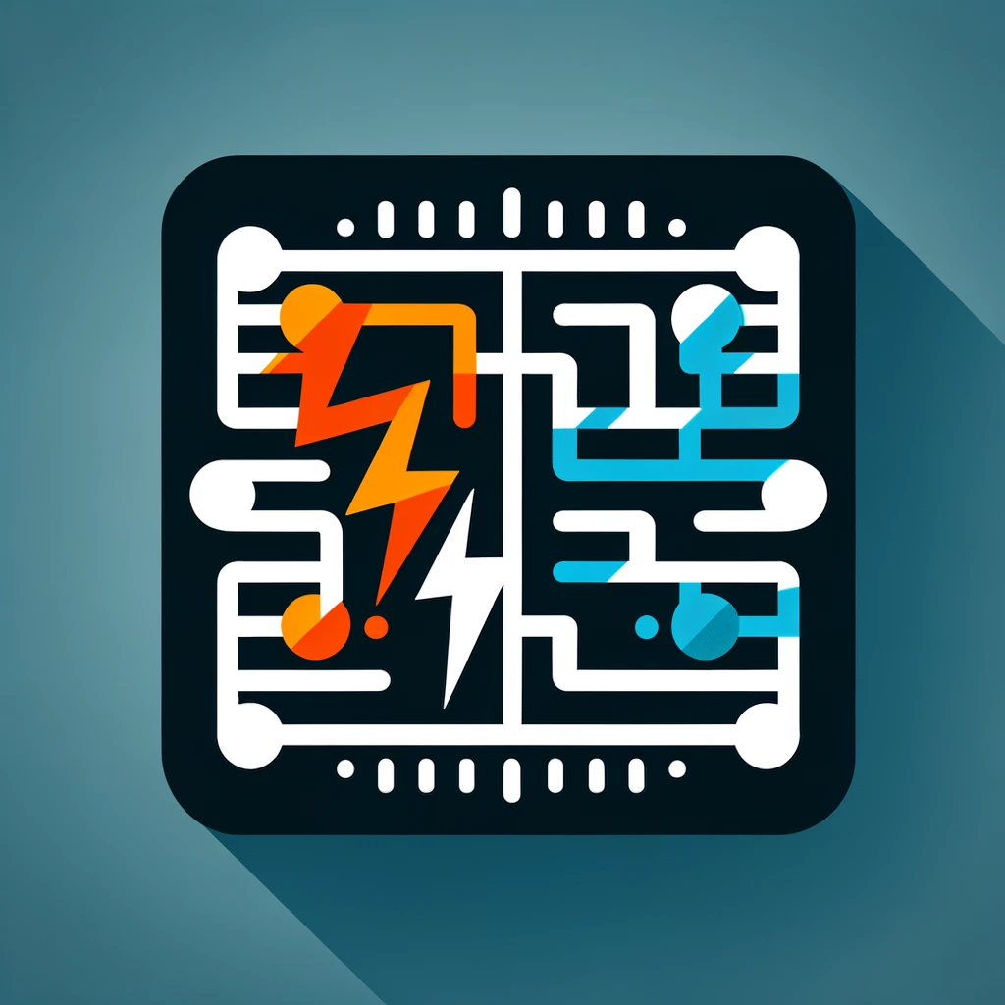



Our Approach
We can mitigate DRAM read disturbance efficiently and scalably by
building a detailed understanding of DRAM read disturbance
leveraging insights into modern DRAM chips and memory controllers
devising novel solutions that do not require proprietary knowledge of DRAM chip internals
MICRO’21
DSN’22
1
Memory access patterns
Temperature
Voltage
Victim cell’s physical location
2
HPCA’24
MICRO’22
HiRA: Parallelizing preventive actions
Svärd: Leveraging heterogeneity
3
HPCA’21
BlockHammer: Selectively throttling unsafe accesses
Notes:
To address these two problems, we conducted several studies encompassed in this thesis statement [CLICK]
We can mitigate DRAM read disturbance efficiently and scalably from three aspects [CLICK]
First, by building a detailed understanding of DRAM read disturbance [CLICK],
Which we explore for temperature [CLICK],
Memory access patterns [CLICK],
Victim cell’s physical location [CLICK],
And voltage [CLICK]
Second, by leveraging insights into modern DRAM chips and memory controllers [CLICK],
Where we leverage the heterogeneity in DRAM cells’ vulnerability levels [CLICK]
and parallelize preventive actions [CLICK]
Third, by devising novel solutions that do not require proprietary knowledge of DRAM chip internals[CLICK],
Which we achieve by selectively throttling unsafe accesses [CLICK]

Slide 32
Core Contributions
building a detailed understanding of DRAM read disturbance
leveraging insights into modern DRAM chips and memory controllers
devising novel solutions that do not require proprietary knowledge of DRAM chip internals
MICRO’21
DSN’22
1
Memory access patterns
Temperature
Voltage
Victim cell’s physical location
2
HPCA’24
MICRO’22
HiRA: Parallelizing preventive actions
Svärd: Leveraging heterogeneity
3
HPCA’21
BlockHammer: Selectively throttling unsafe accesses
Notes:
Without further ado, let’s look into the detailed understanding we built [CLICK]

Slide 33
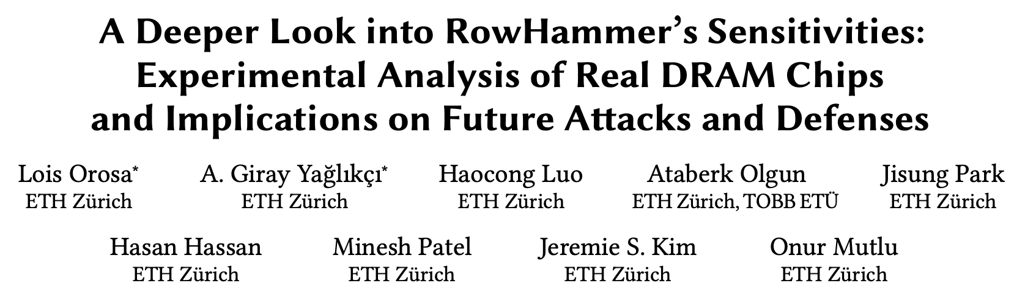
A Deeper Look into RowHammer
Lois Orosa*, Abdullah Giray Yağlıkçı*, Haocong Luo, Ataberk Olgun, Jisung Park, Hasan Hassan, Minesh Patel, Jeremie S. Kim, and Onur Mutlu, "A Deeper Look into RowHammer’s Sensitivities: Experimental Analysis of Real DRAM Chips and Implications on Future Attacks and Defenses" Proceedings of the 54th International Symposium on Microarchitecture (MICRO), Virtual, October 2021. [Slides (pptx) (pdf)] [Talk Video (21 minutes)] [Short Talk Slides (pptx) (pdf)] [Lightning Talk Slides (pptx) (pdf)] [Lightning Talk Video (1.5 minutes)] [arXiv version]
Notes:
Our goal in this work is to Provide insights into three fundamental properties of RowHammer:
Temperature [CLICK]
Aggressor row active time [CLICK]
Victim DRAM cell's physical location [CLICK]
By doing so we aim enabling research to find effective and efficient attacks and defenses [CLICK]

Slide 34
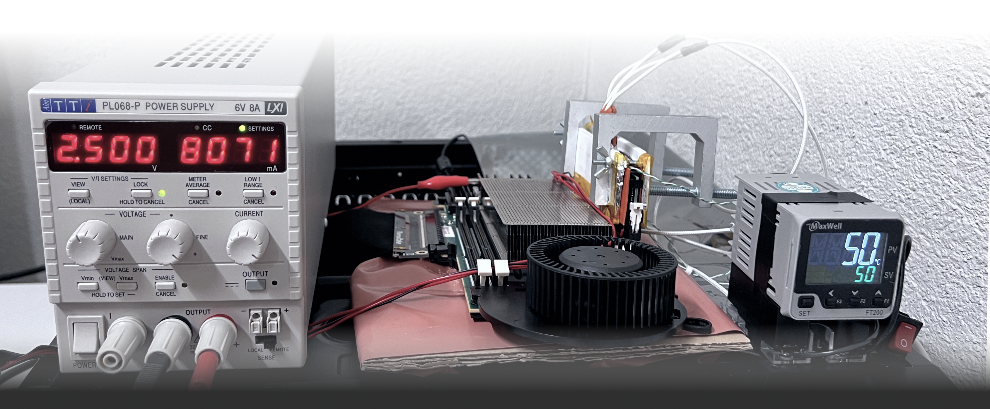
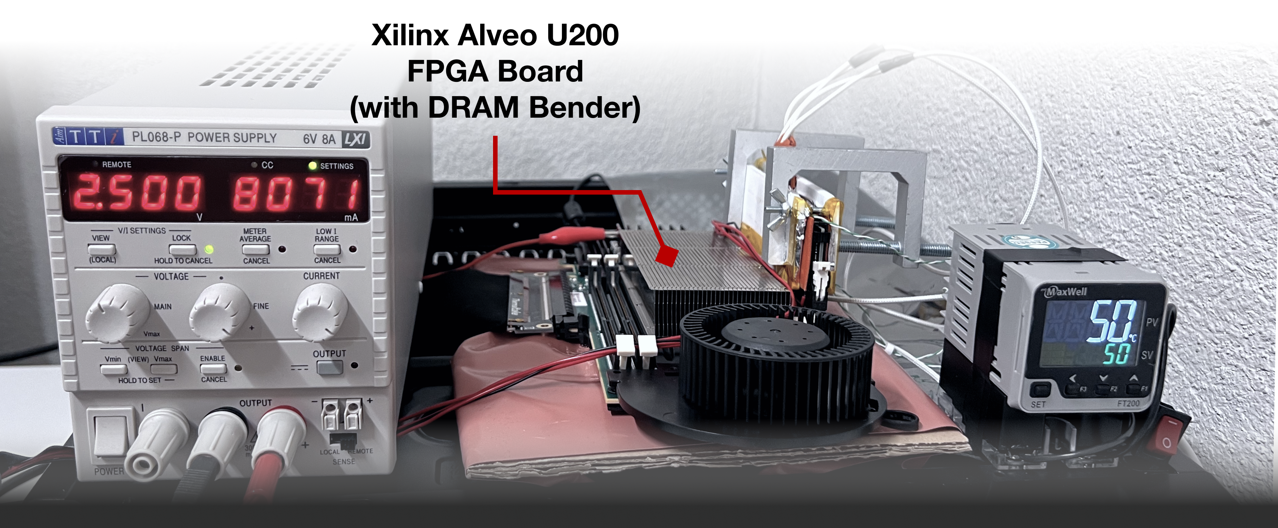
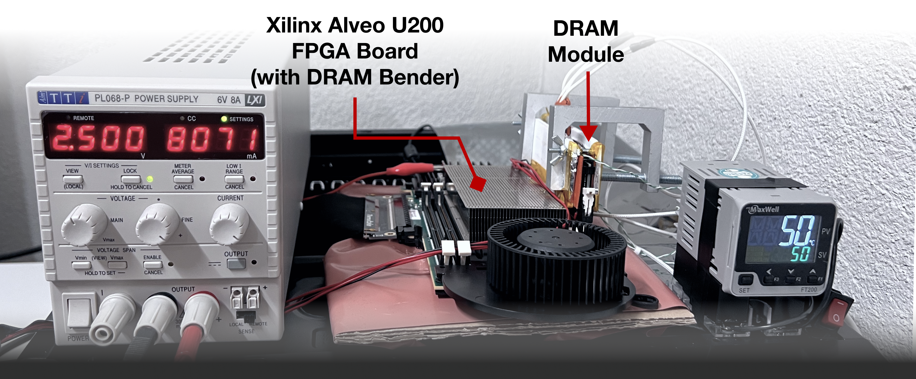
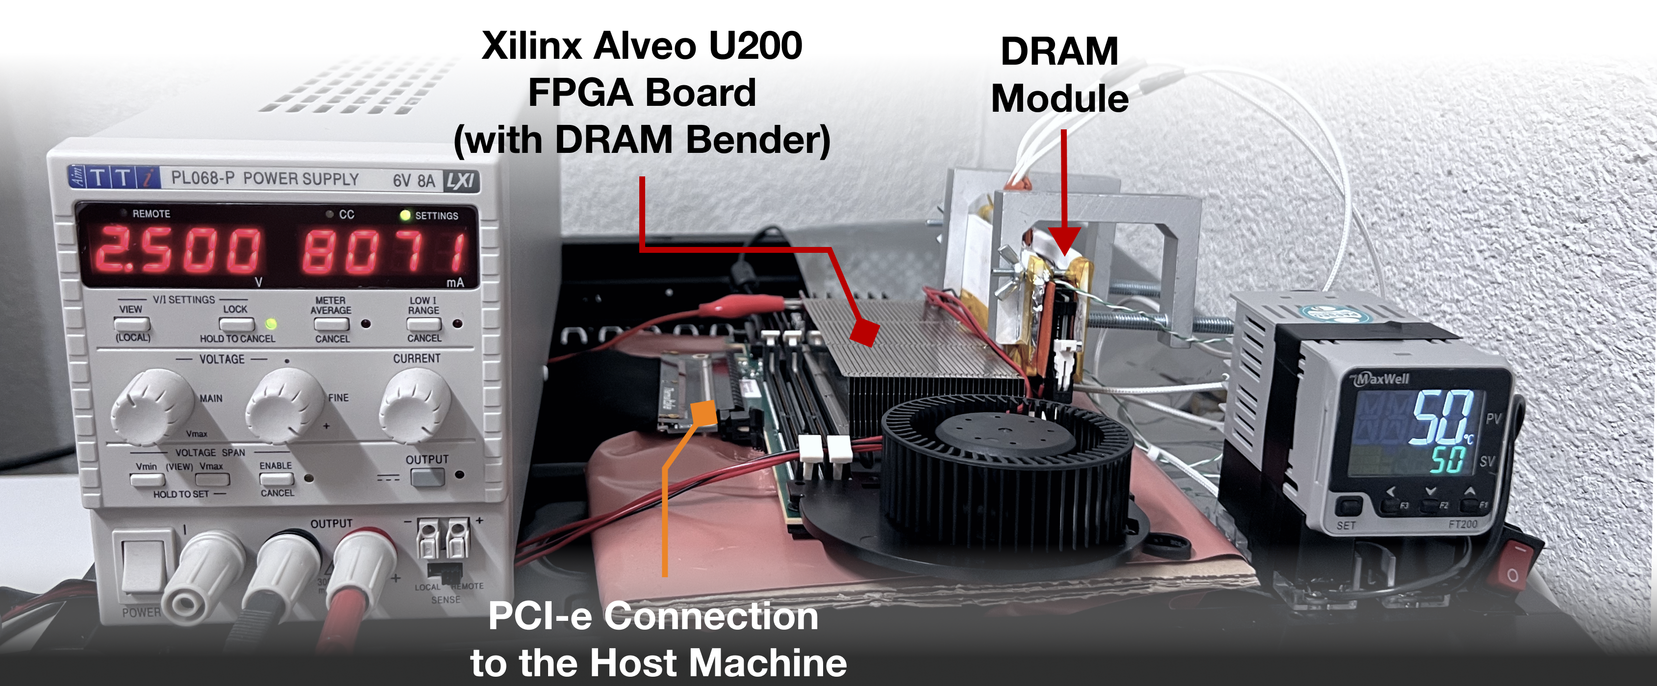
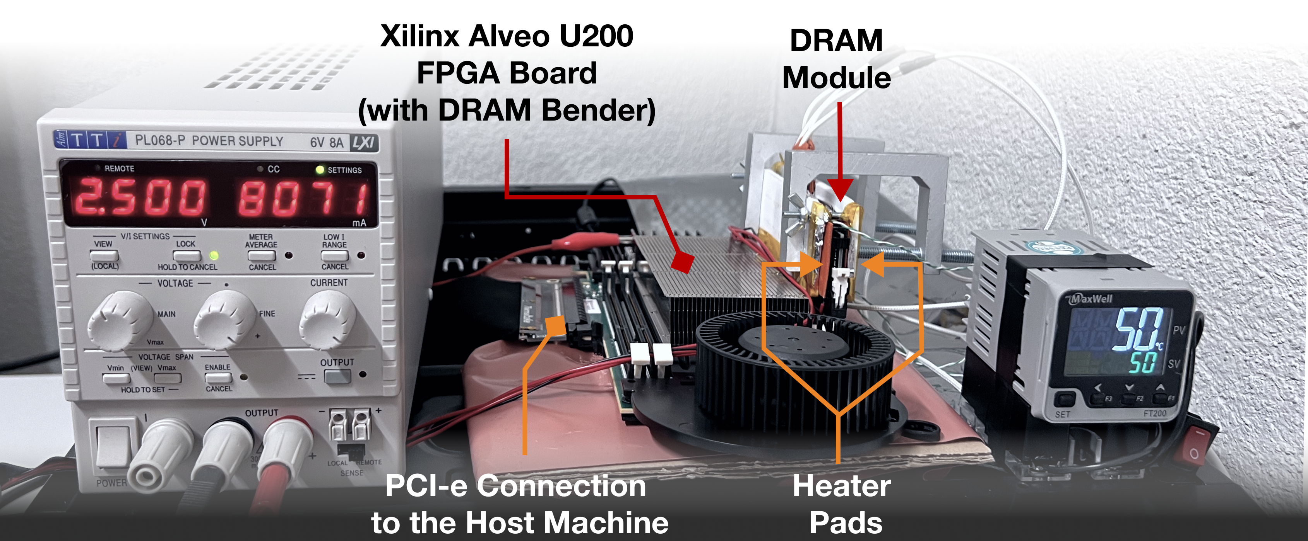
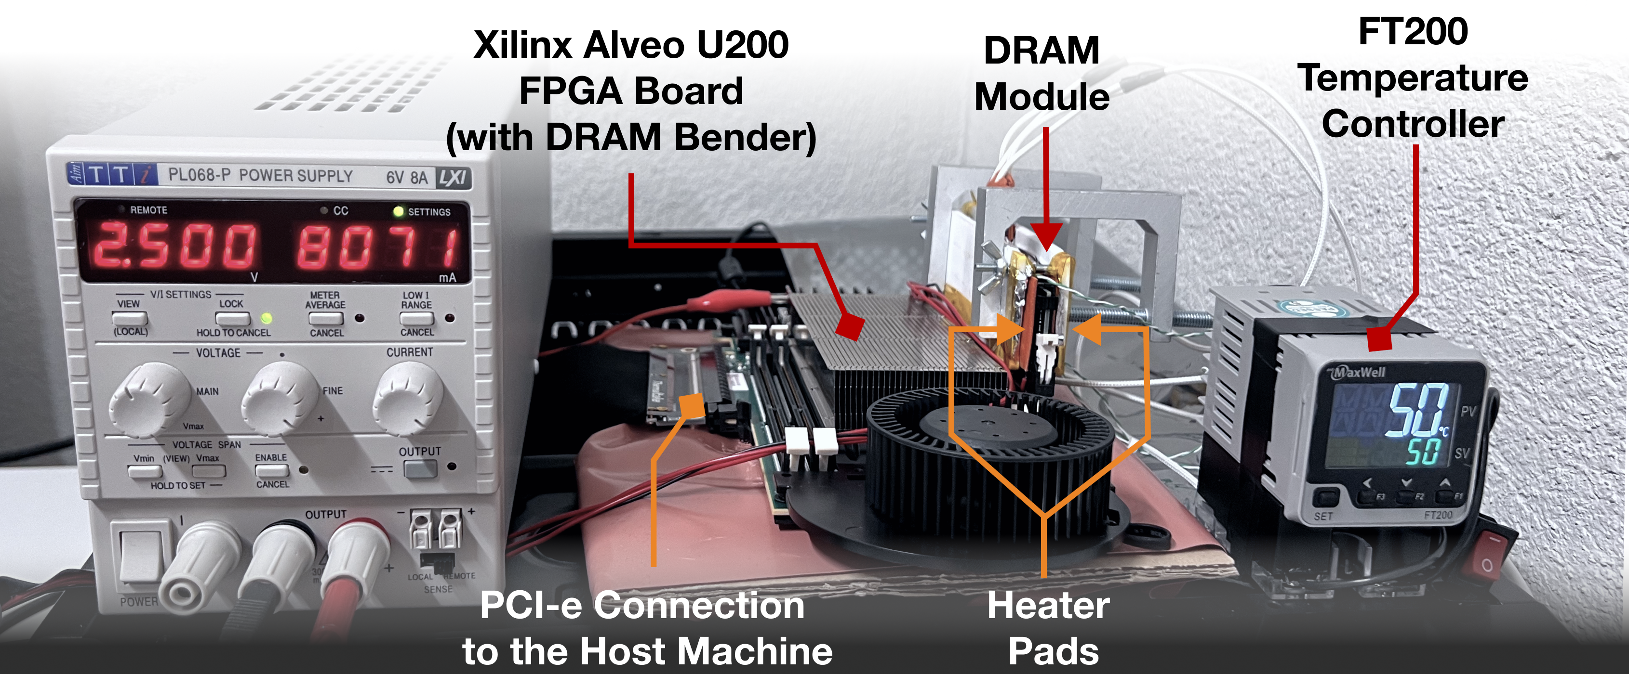
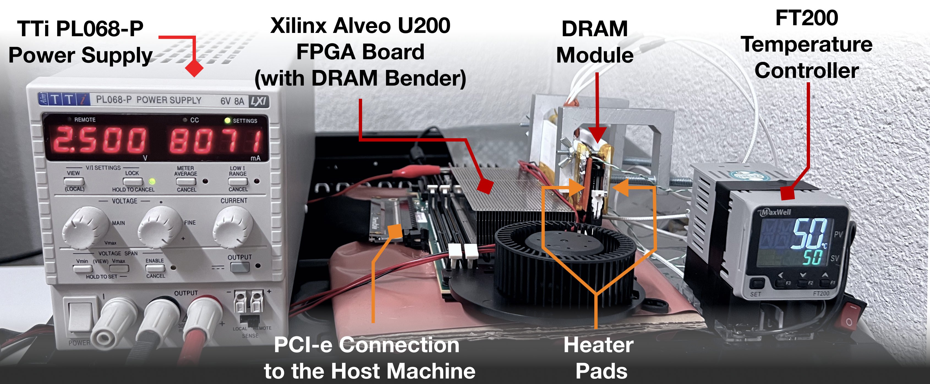
DRAM Testing Infrastructure
DRAM Bender on a Xilinx Virtex UltraScale+ XCU200
*
Fine-grained control over DRAM commands,
timing parameters (±1.5ns), temperature (±0.5°C ),
and voltage (±1mV)
*Olgun et al., “DRAM Bender: An Extensible and Versatile FPGA-based Infrastructure to Easily Test State-of-the-art DRAM Chips,” in TCAD, 2023. [GitHub: https://github.com/CMU-SAFARI/DRAM-Bender]
Notes:
We use an FPGA-based experimental setup programmed with DRAM Bender, which is an open-sourced design available on github [CLICK]
We plug in a DRAM module to test on the FPGA board [CLICK]
The board communicates with the host machine to run the test routines [CLICK]
We control the chip temperature using a pair of heaters [CLICK] connected to a temperature controller [CLICK]
We also have an external power supply that we use to sweep voltage on a power rail [CLICK]
This infrastructure provides fine-grained control over DRAM commands, timing parameters, temperature, and wordline voltage [CLICK]
=======

Slide 35
DRAM Testing Methodology
To characterize our DRAM chips at worst-case conditions:
Prevent sources of interference during core test loop
No DRAM refresh: to avoid refreshing victim row
No DRAM calibration events: to minimize variation in test timing
No RowHammer mitigation mechanisms: to observe circuit-level effects
Test for less than a refresh window (32ms) to avoid retention failures
Worst-case access sequence
We use worst-case access sequence based on prior works’ observations
For each row, repeatedly access the two physically-adjacent rows as fast as possible
Notes:
To characterize our DRAM chips at worst-case conditions we take two measures:
[CLICK] First, we prevent external sources of interference such that our tests can run consistently as desired and without interruptions. To achieve this we disable:
[CLICK] DRAM refresh to avoid refreshing victim rows during a RowHammer test,
[CLICK] DRAM calibration events to minimize variation in test timings
[CLICK] and RowHammer mitigation mechanisms to ensure that we can directly observe circuit-level bit flips
[CLICK] we also ensure that our tests complete in less than a refresh window to prevent retention failures from interfering with our results
[CLICK] Second, we issue the worst-case access sequence for inducing RowHammer bit flips based on observations from prior work
[CLICK] Using these observations, we test each row’s worst-case vulnerability to RowHammer by repeatedly activating the two physically-adjacent rows as fast as possible
=========

Slide 36
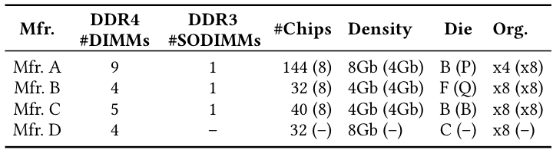
Tested DRAM Chips
272 DRAM Chips (24 DDR3 and 248 DDR4 DRAM Chips)
4 major manufacturers: Micron, Samsung, SK Hynix, and Nanya
2 DRAM standards
Mfr. | DDR4 DIMMs | DDR3 SODIMMs | # Chips | Density | Die | Org.
A (Micron) | 9 | 1 | 144 (8) | 8Gb (4Gb) | B (P) | x4 (x8)
B (Samsung) | 4 | 1 | 32 (8) | 4Gb (4Gb) | F (Q) | x8 (x8)
C (SK Hynix) | 5 | 1 | 40 (8) | 4Gb (4Gb) | B (B) | x8 (x8)
D (Nanya) | 4 | - | 32 (-) | 8Gb (-) | C (-) | x8 (-)
4 major manufacturers
272 DRAM chips
Notes:
In our characterization, [CLICK]
we test 272 real DRAM chips [CLICK]
from four major manufacturers, [CLICK]
that implement DDR3 and DDR4 DRAM standards [CLICK]
and with different densities, die revisions, and chip organizations[CLICK]

Slide 37
Key Finding 1: Temperature Range
DRAM read disturbance is more effective within a bounded vulnerable temperature range
Vulnerable temperature range varies across DRAM cells
Most cells are vulnerable in a continuous temperature range
no bitflips
bitflips
no bitflips
Vulnerable Temperature Range
Temperature
50ºC
90ºC
Lower
Bound
Upper
Bound
Cell A
Vulnerable Temperature Range
Cell B
Vulnerable Temperature Range
Trap-Assisted Charge Leakage Model [Yang+, EDL 2019]
Hammering a wordline pulls and pushes electrons
Electrons get trapped and exacerbate charge leakage, leading to cause bitflips
More vulnerable to RowHammer at temperatures close to a temperature inflection point
Cell C
Vulnerable Temperature Range
Temperature
50ºC
90ºC
Micron | Samsung | SK Hynix | Nanya
99.1% | 98.9% | 98.0% | 99.2%
Orosa, Yağlıkçı et al., "A Deeper Look into RowHammer’s Sensitivities: Experimental Analysis of Real DRAM Chips and Implications on Future Attacks and Defenses" in MICRO, 2021.
Notes:
Our first key finding is about the effect of temperature. [CLICK]
We sweep temperature from 50C to 90C on the x-axis[CLICK],
and show a DRAM cell's read disturbance vulnearbility on the y-axis [CLICK]
We observe that a DRAM cell becomes more vulnerable to read disturbance within a bounded temperature range [CLICK]
and this temperature range significantly varies across DRAM cells [CLICK]
One implication of this finding is for testing routines: To measure a cell's vulnerability to read disturbance, we need to test the cell at all possible operating temperatures [CLICK]
A follow up of this finding uses RowHammer’s temperature sensitivity as a side-channel to spy on a system’s temperature [CLICK]

Slide 38
Key Finding 1: Temperature Range
DRAM read disturbance is more effective within a bounded vulnerable temperature range
Vulnerable temperature range varies across DRAM cells
Most cells are vulnerable in a continuous temperature range
Implication on testing
A DRAM cell should be tested
at each possible operating temperature
no bitflips
bitflips
no bitflips
Vulnerable Temperature Range
Temperature
50ºC
90ºC
Lower
Bound
Upper
Bound
Implication on defenses
A DRAM cell can be retired based on its vulnerable temperature range
Cell A
Vulnerable Temperature Range
Cell B
Vulnerable Temperature Range
Trap-Assisted Charge Leakage Model [Yang+, EDL 2019]
Hammering a wordline pulls and pushes electrons
Electrons get trapped and exacerbate charge leakage, leading to cause bitflips
More vulnerable to RowHammer at temperatures close to a temperature inflection point
Cell C
Vulnerable Temperature Range
Temperature
Follow-up
50ºC
90ºC
This finding paved the way to SpyHammer,
a new attack that spies on temperature [Orosa+, 2022]
Micron | Samsung | SK Hynix | Nanya
99.1% | 98.9% | 98.0% | 99.2%
Orosa, Yağlıkçı et al., "A Deeper Look into RowHammer’s Sensitivities: Experimental Analysis of Real DRAM Chips and Implications on Future Attacks and Defenses" in MICRO, 2021.
Notes:
Our first key finding is about the effect of temperature. [CLICK]
We sweep temperature from 50C to 90C on the x-axis[CLICK],
and show a DRAM cell's read disturbance vulnearbility on the y-axis [CLICK]
We observe that a DRAM cell becomes more vulnerable to read disturbance within a bounded temperature range [CLICK]
and this temperature range significantly varies across DRAM cells [CLICK]
One implication of this finding is for testing routines: To measure a cell's vulnerability to read disturbance, we need to test the cell at all possible operating temperatures [CLICK]
A follow up of this finding uses RowHammer’s temperature sensitivity as a side-channel to spy on a system’s temperature [CLICK]

Slide 39

Key Finding 2: Aggressor Row On Time
on time
Open
Open
Close
Close
A smaller hammer count is sufficient to induce bitflips
with increased aggressor row on time
State-of-the-Art
Our Finding w/ 15 column accesses
36% reduction
Minimum hammer count to induce the first bitflip
Implication on defenses
Existing mitigations are ineffective without this insight
Follow-up
This finding paved the way to the discovery of RowPress [Luo+, ISCA’23]
Orosa, Yağlıkçı et al., "A Deeper Look into RowHammer’s Sensitivities: Experimental Analysis of Real DRAM Chips and Implications on Future Attacks and Defenses" in MICRO, 2021.
Notes:
The second example is about the memory access patterns. [CLICK]
Previously known worst-case access pattern opens and closes an aggressor row as fast as possible [CLICK]
In contrast, in this study, we wait for some time after opening the aggressor row [CLICK]
We observe that doing this significantly reduces the necessary hammer count to induce the first bitflip [CLICK]
An implication is that an existing mitigation can be ineffective if it is not designed accounting for this effect [CLICK]
A follow-up of our work investigates this effect more rigorously and shows that this effect is an artifact of a new read disturbance phenomenon called RowPress [CLICK]

Slide 40

Key Finding 3: Variation across DRAM Rows
All DRAM Rows in a DRAM Bank
90% of rows
Weakest
10% of rows
Say, bitflips occur at
N hammers in these rows
We need at least 2N hammers
to induce bitflips in these rows
RowHammer vulnerability
significantly varies across DRAM rows
Implication on defenses
Configuring a solution for the worst-case overprotects many rows and makes it expensive
Follow-up
This finding paved the way to the design of Svärd [Yaglikci+, HPCA’24] (will be covered)
Orosa, Yağlıkçı et al., "A Deeper Look into RowHammer’s Sensitivities: Experimental Analysis of Real DRAM Chips and Implications on Future Attacks and Defenses" in MICRO, 2021.
Notes:
The third key finding is about the variation of read disturbance across DRAM rows. Assume that this box represents all rows in a bank [CLICK]
If the weakest 10% of the rows experience bitflips after being hammered for N times, [CLICK]
We need at least 2N hammers to induce a bitflip in the remaining 90% [CLICK]
This shows that RowHammer vulnerability significantly varies across DRAM rows [CLICK]
And mitigation mechanisms that are configured for the worst row, overprotect many rows, leading to performance / energy / area overheads [CLICK]

Slide 41
Core Contributions
building a detailed understanding of DRAM read disturbance
leveraging insights into modern DRAM chips and memory controllers
devising novel solutions that do not require proprietary knowledge of DRAM chip internals
MICRO’21
DSN’22
1
Memory access patterns
Temperature
Voltage
Victim cell’s physical location
Voltage
2
HPCA’24
MICRO’22
HiRA: Parallelizing preventive actions
Svärd: Leveraging heterogeneity
3
HPCA’21
BlockHammer: Selectively throttling unsafe accesses
Notes:
Next, I will summarize our DSN22 paper on DRAM read disturbance under reduced wordline voltage

Slide 42

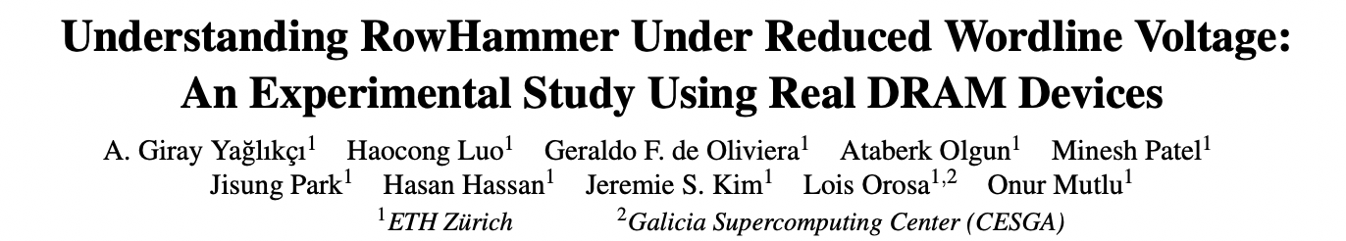
RowHammer Under Reduced Voltage
A. Giray Yağlıkçı, Haocong Luo, Geraldo F. de Oliviera, Ataberk Olgun, Minesh Patel, Jisung Park, Hasan Hassan, Jeremie S. Kim, Lois Orosa, and Onur Mutlu, "Understanding RowHammer Under Reduced Wordline Voltage: An Experimental Study Using Real DRAM Devices" Proceedings of the 52nd Annual IEEE/IFIP International Conference on Dependable Systems and Networks (DSN), Baltimore, MD, USA, June 2022. [Slides (pptx) (pdf)] [Lightning Talk Slides (pptx) (pdf)] [arXiv version] [Talk Video (34 minutes, including Q&A)] [Lightning Talk Video (2 minutes)]

Slide 43
A Closer Look into RowHammer
Bitline
Low Voltage
Victim Row
Aggressor Row
Wordline Voltage
Low Voltage
Victim Row
time
Aggressor Row
Low Voltage
Aggressor Row
Disturbance
Repeatedly toggling
wordline voltage
leads to RowHammer bitflips
High Voltage
Low Voltage
Victim Row
Low Voltage
Victim Row
Yağlıkçı et al., ”Understanding RowHammer Under Reduced Wordline Voltage: An Experimental Study Using Real DRAM Devices," in DSN, 2022.
Notes:
This cartoon provides a closer look into RowHammer. [CLICK]
Asserting high voltage to a row’s wordline for row activation disturbs nearby rows [CLICK]
Repeating this operation [CLICK] many times [CLICK] exacerbates the leakage in victim rows and leads to bit flips [CLICK]
So, repeatedly toggling wordline voltage leads to RowHammer bitflips [CLICK]

Slide 44
Effect of Reducing Wordline Voltage
Reducing wordline voltage
can reduce RowHammer vulnerability
at the cost of weaker cells
Wordline
Voltage
Wordline
Voltage
time
time
Aggressor row
Aggressor row
Victim row
Reduction in disturbance
Victim row
Bitline
Bitline
Wordline
Wordline
Smaller charge
and
weaker channel
Yağlıkçı et al., ”Understanding RowHammer Under Reduced Wordline Voltage: An Experimental Study Using Real DRAM Devices," in DSN, 2022.
Notes:
When we reduce wordline voltage, [CLICK]
we can reduce RowHammer vulnerability [CLICK]
At the potential cost of weakening DRAM cells by reducing their charge and weakening channels in their access transistors [END]

Slide 45
Key Results of Voltage Scaling Study
Reducing wordline voltage can reduce RowHammer vulnerability
15.2% (66.9% max) fewer bitflips occur
7.4% (85.8% max) more activations needed to induce a bitflip
Row activation latency increases with reduced wordline voltage
208 / 272 DRAM chips have no bitflips at nominal latency
Changing timing constraint from 13.5ns to 24ns avoids bitflips
More DRAM cells tend to experience data retention bitflips when wordline voltage is reduced
216 / 272 DRAM chips have no bitflips at nominal refresh rate
SECDED ECC at nominal refresh rate avoids bitflips
16% increase in refresh rate avoids bitflips
Yağlıkçı et al., ”Understanding RowHammer Under Reduced Wordline Voltage: An Experimental Study Using Real DRAM Devices," in DSN, 2022.
Notes:
We begin with investigating wordline voltage's effect on row activation latency [CLICK]
This figure shows how [CLICK]
reducing wordline voltage [CLICK]
affects the row activation latency[CLICK]
We observe that the row activation latency increases with reduced wordline voltage [CLICK]
However, the nominal activation latency already has a significant guardband, [CLICK]
allowing most DRAM chips to complete row activation before the nominal activation latency [END]

Slide 46
Core Contributions
building a detailed understanding of DRAM read disturbance
leveraging insights into modern DRAM chips and memory controllers
devising novel solutions that do not require proprietary knowledge of DRAM chip internals
MICRO’21
DSN’22
1
Memory access patterns
Temperature
Voltage
Victim cell’s physical location
2
HPCA’24
MICRO’22
Svärd: Leveraging heterogeneity
3
HPCA’21
BlockHammer: Selectively throttling unsafe accesses
Notes:
Next, I will summarize how we leverage the heterogeneity in read disturbance vulnerability across DRAM rows [CLICK]

Slide 47
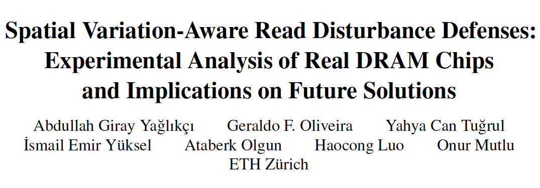
Spatial Variation-Aware Read Disturbance Defenses
A. Giray Yağlıkçı, Geraldo F. de Oliviera, Yahya Can Tuğrul, İsmail Emir Yüksel, Ataberk Olgun, Haocong Luo, and Onur Mutlu, “Spatial Variation-Aware Read Disturbance Defenses: Experimental Analysis of Real DRAM Chips and Implications on Future Solutions,” Proceedings of the 30th Edition of The International Symposium on High-Performance Computer Architecture (HPCA), Edinburgh, Scotland, UK, March 2024. [Slides (pptx) (pdf)] [arXiv version]

Slide 48
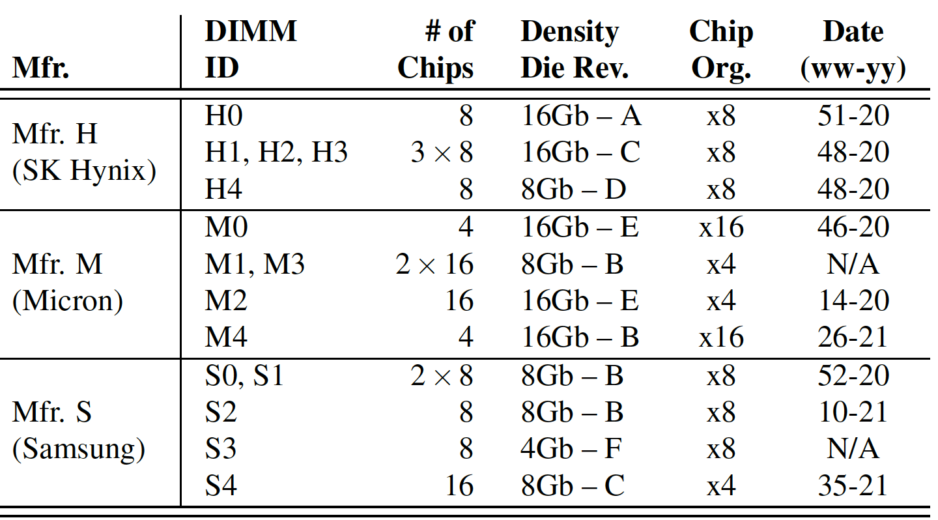
Tested DRAM Chips
144 DDR4 DRAM chips from SK Hynix, Micron, and Samsung
All rows in four different banks
Notes:
We test 144 DRAM chips [CLICK]
That implement various densities-die revisions [CLICK]
And chip organizations [CLICK]

Slide 49
Spatial Variation-Aware Mitigation
Significant and irregular variation in read disturbance vulnerability across DRAM rows
Read disturbance solutions:
Configured for the worst row
Overprotect many rows
Incur large performance overheads
Key Idea: Dynamically tune the aggressiveness of existing solutions to the victim row’s read disturbance vulnerability
Svärd: Spatial Variation-Aware Read Disturbance Defenses
Fewer preventive actions (e.g., refresh) for stronger rows
*Svärd is the Swedish word for sword, a weapon with a long blade for cutting or thrusting [Merriam-Webster]
Yağlıkçı et al., "Spatial Variation-Aware Read Disturbance Defenses:
Experimental Analysis of Real DRAM Chips and Implications on Future Solutions,” in HPCA, 2024.
Notes:
As I described earlier, there is a signficant variation in read disturbance vulnerability across DRAM rows [CLICK]
Existing solutions are configured for the worst row, [CLICK]
leading to overprotecting many rows and thus incurring large performance overheads [CLICK]
Our key idea is to dynamically tune the aggressiveness of existing solutions to the victim row’s read disturbance vulnerability [CLICK]
To this end, we propose a new mechanism called Svard, spatial variation-aware read disturbance defenses [CLICK]
Svard essentially performs fewer preventive actions for stronger rows [CLICK]

Slide 50
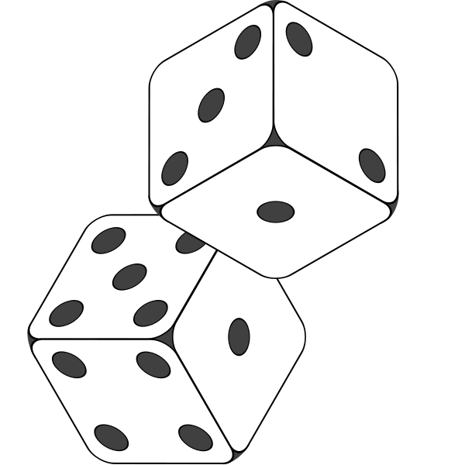
Integrating Svärd with Existing Solutions
PARA: Probabilistic Row Activation [Kim+, ISCA’14]
Random
Number
Yes
Preventively
refresh the victim row
Row
Activation
>
Threshold
>
Threshold
victim row
Less vulnerable
Svärd
Higher threshold
→ Fewer refresh
More vulnerable
Lower threshold
→ More aggressive refresh
Svärd works with many other read disturbance solutions, including:
AQUA [Saxena+, MICRO’22]
BlockHammer [Yaglikci+, HPCA’21]
Hydra [Qureshi+, ISCA’22]
RRS [Saileshwar+, ASPLOS’22]
Yağlıkçı et al., "Spatial Variation-Aware Read Disturbance Defenses:
Experimental Analysis of Real DRAM Chips and Implications on Future Solutions,” in HPCA, 2024.

Slide 51
Performance Evaluation
Cycle-level simulations using Ramulator 2.0 [Luo+, CAL 2023]
System Configuration:
Workloads: 120 different 8-core multiprogrammed workloads from SPEC CPU2006, SPEC CPU2017, TPC, MediaBench, and YCSB benchmark suites
Integrated with AQUA, BlockHammer, PARA, Hydra, and RRS
HC_{first}: {4K, 2K, 1K, 512, 256, 128, 64} hammers The minimum hammer count needed to induce the first bitflip
Processor | 3.2 GHz, 8 core, 4-wide issue, 128-entry instr. window
Last-Level Cache | 64-byte cache line, 8-way set-associative, 8 MB
Memory Scheduler | FR-FCFS
Address Mapping | Minimalistic Open Pages
Main Memory | DDR4, 4 bank group, 4 banks per bank group (16 banks per rank)
Yağlıkçı et al., "Spatial Variation-Aware Read Disturbance Defenses:
Experimental Analysis of Real DRAM Chips and Implications on Future Solutions,” in HPCA, 2024.
Notes:
We use Ramulator for cycle-level simulations in our performance evaluation [CLICK]
We simulate a realistic system with the shown parameters that I will not explain in detail [CLICK]
We simulate 125 different 8-core multiprogrammed workloads [CLICK]
We sweep DRAM chip capacity from 2Gb to 128Gb [CLICK]
And RowHammer threshold: the minimum number of activations needed to induce the first RowHammer bit flip from 1K to 64 [CLICK]

Slide 52
Key Results
Svärd reduces the performance overhead of existing solutions and significantly improves system throughput
Svärd’s hardware complexity:
AQUA [Saxena+, MICRO’22]
1.6x
BlockHammer [Yaglikci+, HPCA’21]
4.9x
Hydra [Qureshi+, ISCA’22]
1.1x
PARA [Kim+, ISCA’14]
2.0x
RRS [Saileshwar+, ASPLOS’22]
4.8x
No
Additional
Latency
In-DRAM
Implementation
0.006%
In-Processor
Implementation
0.027%
Yağlıkçı et al., "Spatial Variation-Aware Read Disturbance Defenses:
Experimental Analysis of Real DRAM Chips and Implications on Future Solutions,” in HPCA, 2024.

Slide 53
Core Contributions
building a detailed understanding of DRAM read disturbance
leveraging insights into modern DRAM chips and memory controllers
devising novel solutions that do not require proprietary knowledge of DRAM chip internals
MICRO’21
DSN’22
1
Memory access patterns
Temperature
Voltage
Victim cell’s physical location
2
HPCA’24
MICRO’22
HiRA: Parallelizing Preventive Actions
3
HPCA’21
BlockHammer: Selectively throttling unsafe accesses
Notes:
Without further ado, let’s look into the detailed understanding we built [CLICK]

Slide 54

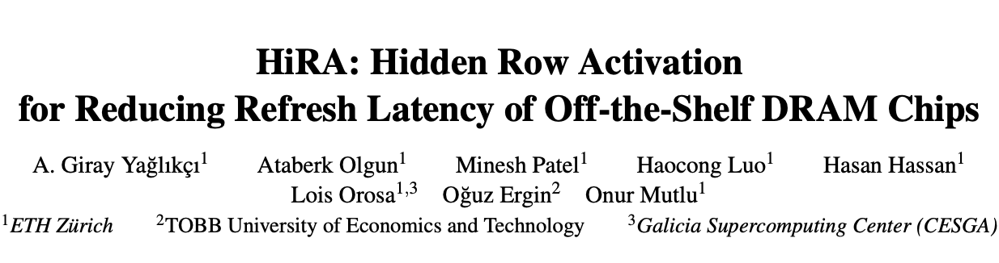
HiRA: Hidden Row Activation
Abdullah Giray Yağlıkçı, Ataberk Olgun, Minesh Patel, Haocong Luo, Hasan Hassan, Lois Orosa, Oguz Ergin, and Onur Mutlu, "HiRA: Hidden Row Activation for Reducing Refresh Latency of Off-the-Shelf DRAM Chips,” in MICRO 2022. [Slides (pptx) (pdf)] [Longer Lecture Slides (pptx) (pdf)] [Lecture Video (36 minutes)] [arXiv version]

Slide 55
Subarray-Level Parallelism
Each subarray is mostly independent…
except occasionally sharing global structures
Subarray_{N}
Local Row-Buf
Global Decoder
···
Subarray₁
Local Row-Buf
Bank
Global I/O
Yoongu Kim, et al., "A Case for Exploiting Subarray-Level Parallelism (SALP) in DRAM,” in ISCA, 2012
Notes:
Based on our observation, we propose two key ideas.
First, we realized that each subarray operates mostly independently of each other, except when occasionally sharing global structures, such as the global row-buffer. Additionally, each subarray has a row-decoder, which in turn is driven by the global row-decoder, another global structure.
Our first key idea is to reduce the sharing of global structures among subarrays to enable subarray-level parallelism.

Slide 56
DRAM Refresh
DRAM Subarray
DRAM cells leak charge over time
Fully charged
1
1
1
1
time
DRAM Refresh
Row
Buffer
DRAM Refresh is the key maintenance operation to avoid bit flips due to charge leakage
Activates (ACT) a row and precharges (PRE) the bank
Problem: DRAM Refresh blocks accesses to the whole bank / rank
Yağlıkçı et al., "HiRA: Hidden Row Activation for Reducing Refresh Latency
of Off-the-Shelf DRAM Chips,” in MICRO, 2022.
Notes:
DRAM cells leak charge over time [CLICK]
And need to be refreshed to avoid bit flips due to leakage [CLICK]
DRAM Refresh essentially activates a row [CLIcK] and precharges the bank after the cell charges are restored [CLICK]
Unfortunately, the whole DRAM bank or rank becomes unavailable during a refresh operation [CLICK]

Slide 57
HiRA: Hidden Row Activation – Key Insight
Concurrently activating two rows in different subarrays of the same bank can refresh one row while opening the other row
Subarray X
ACT
Row A
Refreshes RowA
concurrently with
Subarray Y
ACT
Row B
opening RowB
DRAM Bank
Yağlıkçı et al., "HiRA: Hidden Row Activation for Reducing Refresh Latency
of Off-the-Shelf DRAM Chips,” in MICRO, 2022.
Notes:
HiRA is based on the key insight that [CLICK]
activating two rows in quick succession [CLICK]
That are in different subarrays in the same bank[CLICK]
Can refresh one row [CLICK]
Concurrently with activating the other row [CLICK]

Slide 58
HiRA: Hidden Row Activation
Refresh RowA concurrently with Activating RowB
RowA’s
refresh
Precharge
RowB’s activation
Without HiRA
time
ACT
RowA
PRE
ACT
RowB
RD
RD
PRE
HiRA
PRE
With HiRA
time
ACT
RowA
ACT
RowB
RD
RD
PRE
RowB’s activation
Saved time using HiRA
Reduction in the time spent for two refreshes
RowA’s
refresh
Yağlıkçı et al., "HiRA: Hidden Row Activation for Reducing Refresh Latency
of Off-the-Shelf DRAM Chips,” in MICRO, 2022.
Notes:
Here is an example of how HiRA refreshes a RowA concurrently with activating a RowB [CLICK]
Without HiRA, only one row can be activated in a bank at a given time [CLICK]
Therefore, we activate RowA, wait until the row is refreshed [CLICK]
Precharge the bank [CLICK]
And activate RowB to read data from RowB [CLICK]
With HiRA, [CLICK]
We issue ACT-PRE-ACT command sequence [CLICK]
Which starts RowA’s refresh with the first ACT [CLICK]
And RowB’s activation with the second ACT [CLICK]
With this parallelization, we can perform the column access earlier [CLICK]

Slide 59
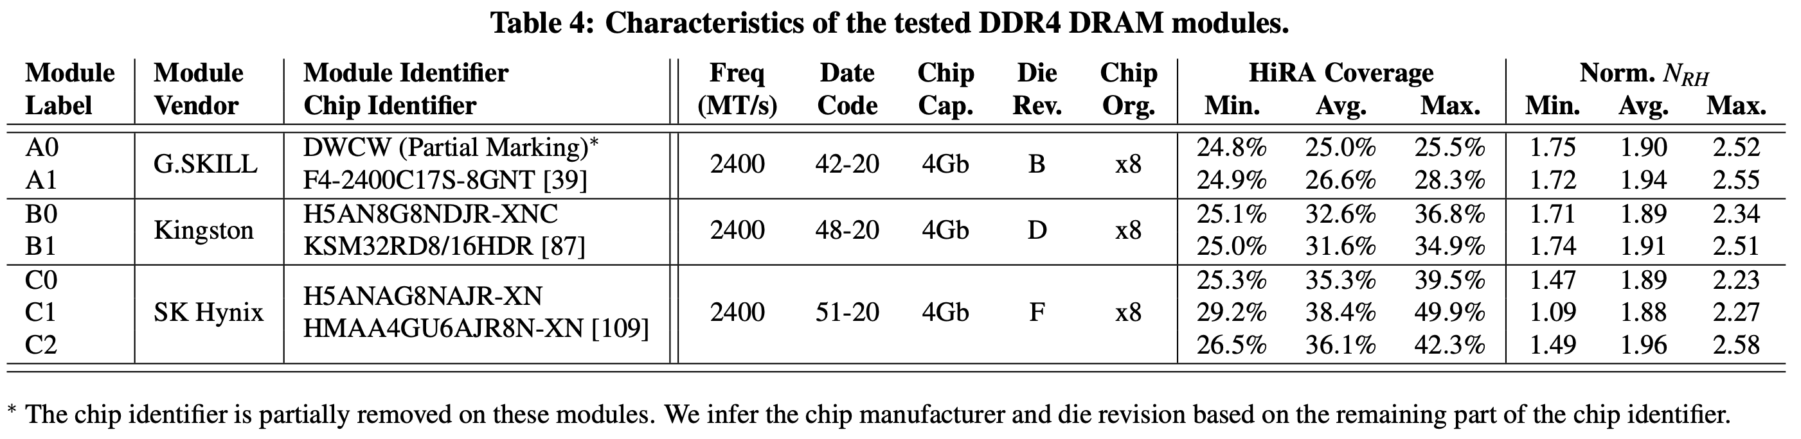
HiRA in Off-the-Shelf DRAM Chips
HiRA works in 56 off-the-shelf DRAM chips from SK Hynix
51.4% reduction in the time spent for refresh operations
HiRA effectively reduces the time spent for refresh operations in off-the-shelf DRAM chips
Notes:
And we observe that HiRA reduces time spent for refresh operations by 51.4% [CLICK]
Therefore, we conclude that HiRA effectively reduces the time spent for refresh operation in off-the-shelf DRAM chips [CLICK]

Slide 60
HiRA-MC: HiRA Memory Controller
Generates each periodic refresh and RowHammer-preventive refresh with a deadline
Buffers each refresh request and performs the refresh request until the deadline
Finds if it can refresh a DRAM row concurrently with a DRAM access or another refresh
1
2
3
Notes:
HiRA-MC contains the necessary components to timely generate each periodic and RowHammer-preventive refresh request with a deadline [CLICK]
To buffer each refresh request until its deadline [CLICK]
And to find if it can refresh a row concurrently with a DRAM access or another refresh request [CLICK]

Slide 61
Performance Evaluation
Cycle-level simulations using Ramulator [Kim+, CAL 2015]
System Configuration:
Workloads: 125 different 8-core multiprogrammed workloads from the SPEC2006 benchmark suite
DRAM Chip Capacity: {2, 4, 8, 16, 32, 64, 128} Gb
RowHammer Threshold: {1024, 512, 256, 128, 64} activations The minimum hammer count needed to induce the first RowHammer bitflip
Processor | 3.2 GHz, 8 core, 4-wide issue, 128-entry instr. window
Last-Level Cache | 64-byte cache line, 8-way set-associative, 8 MB
Memory Scheduler | FR-FCFS
Address Mapping | Minimalistic Open Pages
Main Memory | DDR4, 4 bank group, 4 banks per bank group (16 banks per rank)
Timing Parameters | t₁=t₂=3ns, t_{RC}= 46.25ns, t_{FAW}=16ns
Notes:
We use Ramulator for cycle-level simulations in our performance evaluation [CLICK]
We simulate a realistic system with the shown parameters that I will not explain in detail [CLICK]
We simulate 125 different 8-core multiprogrammed workloads [CLICK]
We sweep DRAM chip capacity from 2Gb to 128Gb [CLICK]
And RowHammer threshold: the minimum number of activations needed to induce the first RowHammer bit flip from 1K to 64 [CLICK]

Slide 62
Key Results of HiRA
Performance Evaluation
3.7x speedup by reducing time spent on RowHammer-preventive refreshes
12.6% speedup by reducing time spent on periodic refreshes
Hardware Complexity Analysis
Chip area cost of 0.0023% of a processor die
No additional latency overhead
Yağlıkçı et al., "HiRA: Hidden Row Activation for Reducing Refresh Latency
of Off-the-Shelf DRAM Chips,” in MICRO, 2022.
Notes:
And we observe that HiRA reduces time spent for refresh operations by 51.4% [CLICK]
Therefore, we conclude that HiRA effectively reduces the time spent for refresh operation in off-the-shelf DRAM chips [CLICK]

Slide 63
Core Contributions
building a detailed understanding of DRAM read disturbance
leveraging insights into modern DRAM chips and memory controllers
devising novel solutions that do not require proprietary knowledge of DRAM chip internals
MICRO’21
DSN’22
1
Memory access patterns
Temperature
Voltage
Victim cell’s physical location
2
HPCA’24
MICRO’22
3
HPCA’21
BlockHammer: Selectively throttling unsafe accesses
Notes:
Without further ado, let’s look into the detailed understanding we built [CLICK]

Slide 64

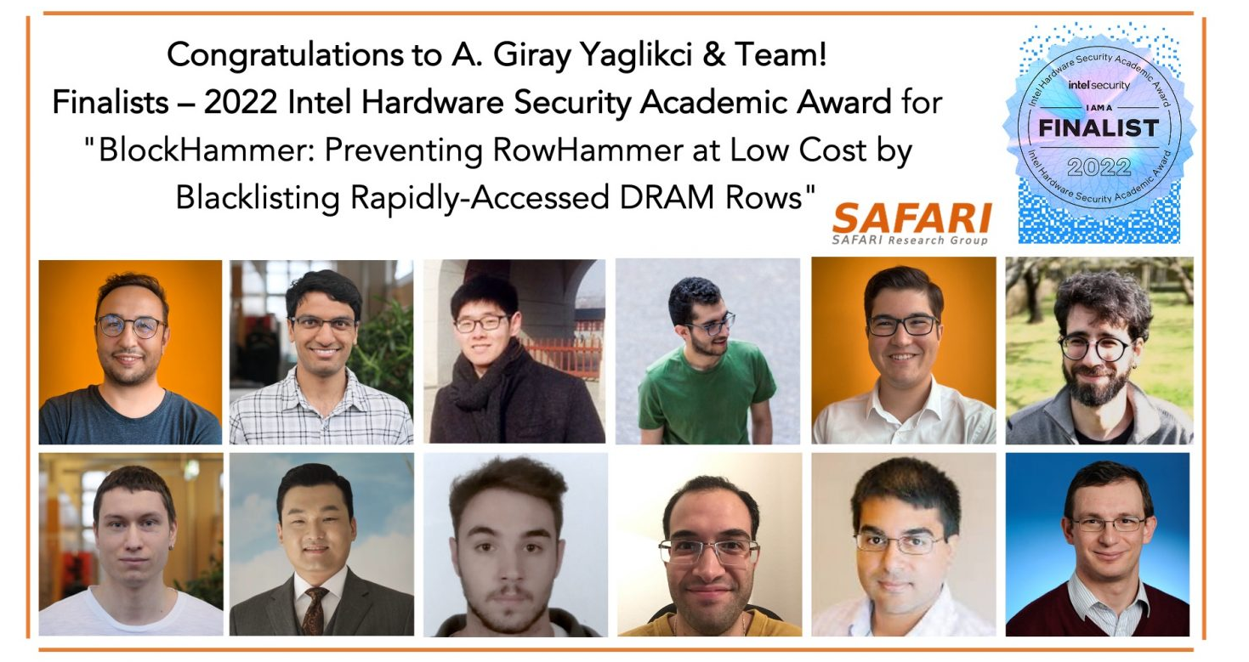
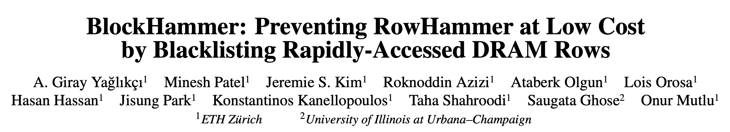
BlockHammer
A. Giray Yaglikci, Minesh Patel, Jeremie S. Kim, Roknoddin Azizi, Ataberk Olgun, Lois Orosa, Hasan Hassan, Jisung Park, Konstantinos Kanellopoulos, Taha Shahroodi, Saugata Ghose, and Onur Mutlu, "BlockHammer: Preventing RowHammer at Low Cost by Blacklisting Rapidly-Accessed DRAM Rows" Proceedings of the 27th International Symposium on High-Performance Computer Architecture (HPCA), Virtual, February-March 2021. [Slides (pptx) (pdf)] [Short Talk Slides (pptx) (pdf)] [Intel Hardware Security Academic Awards Short Talk Slides (pptx) (pdf)] [Talk Video (22 minutes)] [Short Talk Video (7 minutes)] [Intel Hardware Security Academic Awards Short Talk Video (2 minutes)] [BlockHammer Source Code] Intel Hardware Security Academic Award Finalist (one of 4 finalists out of 34 nominations)
Notes:
We provide more analyses and implementation details available in the full paper.
[CLICK] First, the paper shares a security proof where we mathematically represent ALL POSSIBLE access patterns and show that NO ROW can be activated at a high-enough rate to induce bit-flips when BlockHammer is configured correctly.
[CLICK] Second, the paper explains how BlockHammer addresses many-sided attacks by tuning its thresholds.
[CLICK] Third, we evaluate all four high-level RowHammer mitigation approaches through analyzing 14 mechanisms from four aspects
[CLICK] comprehensive protection
[CLICK] compatibiltiy with commodity DRAM chips
[CLICK] scalability with worsening RowHammer vulnerability
[CLICK] and deterministic protection.
[CLICK] We show that BlockHammer is the only mechanism that satisfies all of them.
[END]

Slide 65

BlockHammer: Key Idea
Application
Level
Virtual Memory Address
In-DRAM Mapping
Proprietary
Processor-visible
Row Addresses
System
Level
Physical Memory Address
Memory
Controller
DRAM Bus Addresses
(Channel, Rank, Bank, Row…)
Physical Row Addresses
Visible within the processor
DRAM chip
A RowHammer attack hammers Row A
BlockHammer detects hammered rows using area-efficient Bloom filters
Selectively throttles accesses targeting hammered rows
Victim
Rows
???
Row A
Row A-1
Row A+1
Physical Row Layout
BlockHammer prevents read disturbance bitflips without the knowledge of or modifications to DRAM chip internals
Notes:
The second problem is about compatibility with DRAM communication protocols [CLICK]
Let’s recap how we manage memory addresses. We use virtual addresses in the application level [CLICK]
The system software translates them to physical addresses [CLICK]
Which then parsed in the memory controller to identify DRAM bus addresses, such as banks and rows [CLICK]
All these translations are visible within the processor [CLICK]
However, yet another translation is performed within the DRAM chips from processor-visible addresses to physical row addresses [CLICK]
This translation is proprietary information of the DRAM vendors and obfuscated from the processor [CLICK]
When a RowHammer attack hammers a Row A [CLICK]
A defense implemented in the processor can detect this attack [CLICK]
And preventively refresh row addresses A+1 and A-1, which may not correspond to actual victim rows [CLICK]
As a result, bitflips still may occur [CLICK]
Unfortunately, many existing solutions rely on this proprietary information [CLICK]

Slide 66
BlockHammer: Evaluation (1/2)
Qualitative comparison against 14 mechanisms
Comprehensive protection
Compatibility with commodity DRAM chips
Scalability with worsening RowHammer vulnerability
Deterministic protection
Quantitative comparison against 6 state-of-the-art mechanisms
PARA [Kim+, ISCA’14]
ProHIT [Son+, DAC’17]
MRLoc [You+, DAC’19]
BlockHammer is the only mechanism that satisfies
all four properties
CBT [Seyedzadeh+, ISCA’18]
TWiCe [Lee+, ISCA’19]
Graphene [Park+, MICRO’20]
BlockHammer is low cost and competitive

Slide 67
BlockHammer: Evaluation (2/2)
Cycle-level simulations using Ramulator and DRAMPower
System Configuration:
Single-Core Benign Workloads:
22 SPEC CPU 2006
4 YCSB Disk I/O
2 Network Accelerator Traces
2 Bulk Data Copy with Non-Temporal Hint (movnti)
Randomly Chosen Multiprogrammed Workloads:
125 workloads containing 8 benign applications
125 workloads containing 7 benign applications and 1 RowHammer attack
Processor | 3.2 GHz, {1,8} core, 4-wide issue, 128-entry instr. window
LLC | 64-byte cache line, 8-way set-associative, {2,16} MB
Memory scheduler | FR-FCFS
Address mapping | Minimalistic Open Pages
DRAM | DDR4 1 channel, 1 rank, 4 bank group, 4 banks per bank group
RowHammer Threshold | 32K → 1K
Notes:
We conduct cycle-level simulations using RAMULATOR and DRAMPOWER to evaluate the performance and DRAM energy consumption.
[CLICK] We simulate a realistic system with a DDR4 DRAM module.
[CLICK] We use single-core workloads from four benchmarks in our simulations.
22 SPEC benchmarks, 4 disk I/O memory access traces from YCSB benchmark suite, 2 memory access traces collected from a network accelerator chip, and 2 synthetic traces that mimic bulk data copy with non-temporal hint.
[CLICK] We randomly combine these workloads to create two types of eight-core multiprogrammed workloads:
[CLICK] workloads that contain eight benign applications
[CLICK] and workloads that contain seven benign applications along with one thread performing RowHammer attack.

Slide 68
BlockHammer: Evaluation (2/2)
Cycle-level simulations using Ramulator and DRAMPower
System Configuration:
Single-Core Benign Workloads:
22 SPEC CPU 2006
4 YCSB Disk I/O
2 Network Accelerator Traces
2 Bulk Data Copy with Non-Temporal Hint (movnti)
Randomly Chosen Multiprogrammed Workloads:
125 workloads containing 8 benign applications
125 workloads containing 7 benign applications and 1 RowHammer attack
No RowHammer attack: Negligible (<0.6%) performance and energy overheads
Processor | 3.2 GHz, {1,8} core, 4-wide issue, 128-entry instr. window
LLC | 64-byte cacheline, 8-way set-associative, {2,16} MB
Memory scheduler | FR-FCFS
Address mapping | Minimalistic Open Pages
DRAM | DDR4 1 channel, 1 rank, 4 bank group, 4 banks per bank group
RowHammer Threshold | 32K
RowHammer attack present: Significant improvement on system performance (71%) and energy consumption (32%)
Notes:
We conduct cycle-level simulations using RAMULATOR and DRAMPOWER to evaluate the performance and DRAM energy consumption.
[CLICK] We simulate a realistic system with a DDR4 DRAM module.
[CLICK] We use single-core workloads from four benchmarks in our simulations.
22 SPEC benchmarks, 4 disk I/O memory access traces from YCSB benchmark suite, 2 memory access traces collected from a network accelerator chip, and 2 synthetic traces that mimic bulk data copy with non-temporal hint.
[CLICK] We randomly combine these workloads to create two types of eight-core multiprogrammed workloads:
[CLICK] workloads that contain eight benign applications
[CLICK] and workloads that contain seven benign applications along with one thread performing RowHammer attack.

Slide 69
Conclusion
We can mitigate DRAM read disturbance efficiently and scalably by
building a detailed understanding of DRAM read disturbance
leveraging insights into modern DRAM chips and memory controllers
devising novel solutions that do not require proprietary knowledge of DRAM chip internals
MICRO’21
DSN’22
1
Memory access patterns
Temperature
Victim cell’s physical location
Voltage
2
HPCA’24
MICRO’22
3
HPCA’21

Slide 70
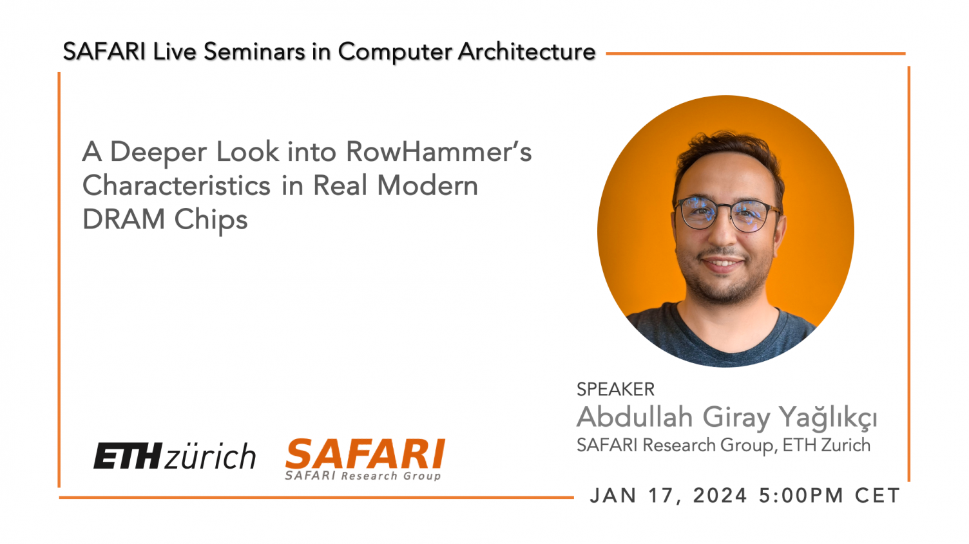

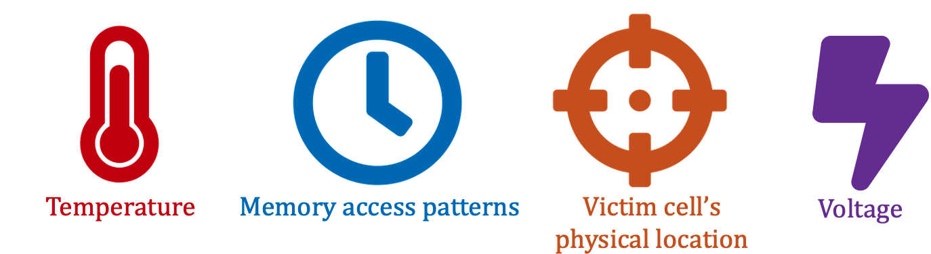
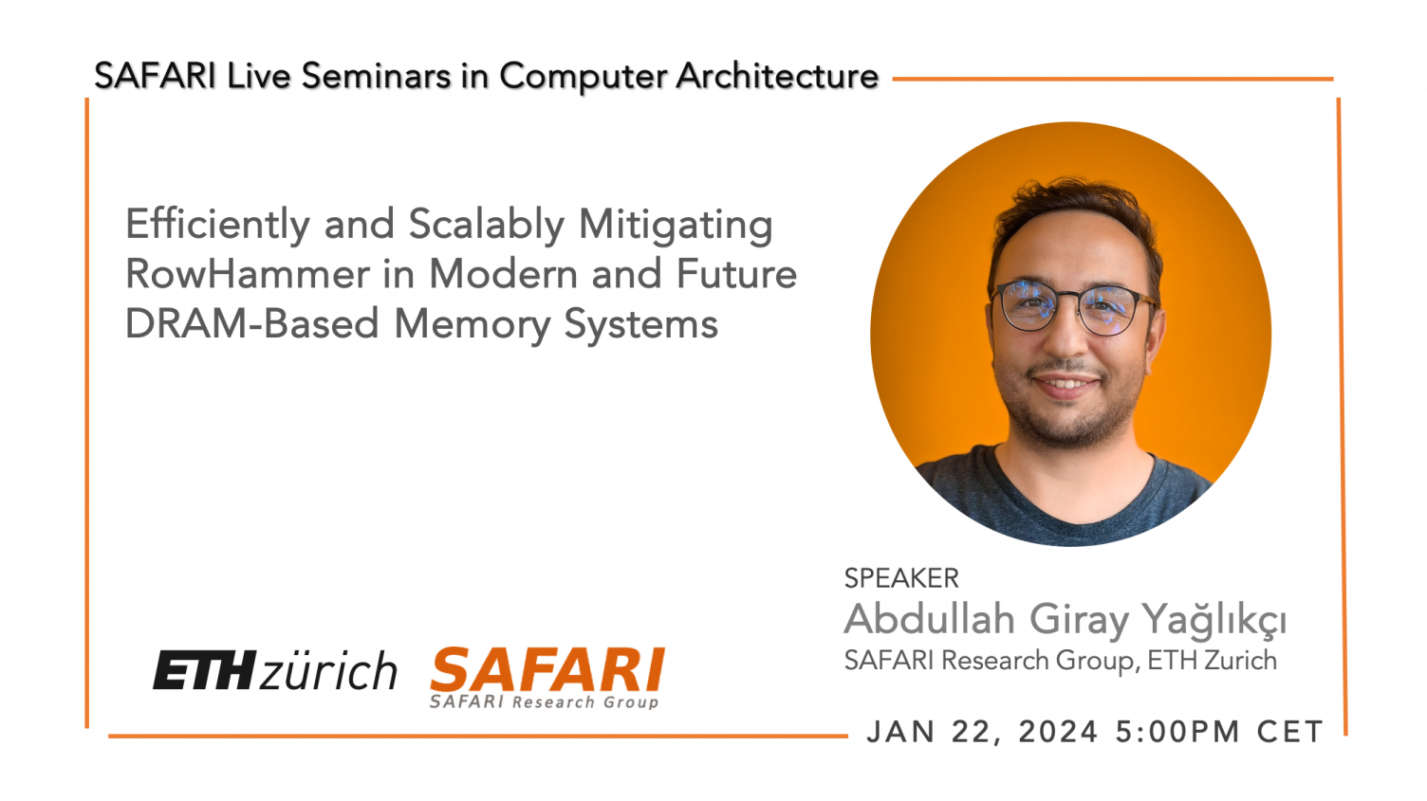

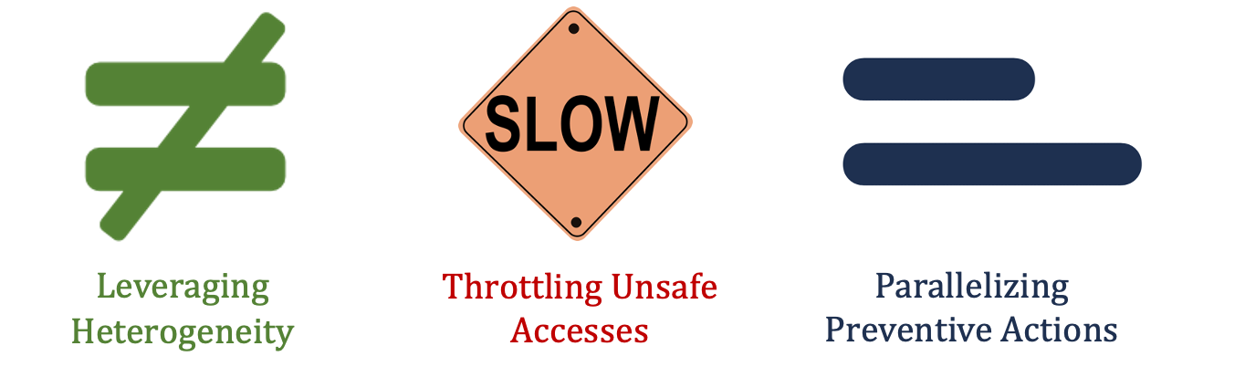
More Details and Discussion on YouTube
https://www.youtube.com/live/CRtm1es4n3o?si=8N5zB6e_RUc5Ejl8
https://www.youtube.com/live/YQwRYWpCsk0?si=jXPueMHb5wgs69-q

Slide 71
Industry Solutions to RowHammer

Slide 72
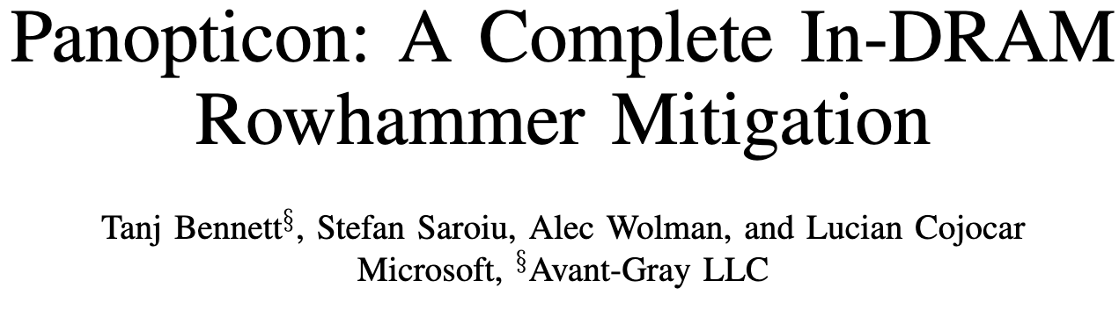
Per-Row Activation Counters in DRAM
Tanj Bennett, Stefan Saroiu, Alec Wolman, and Lucian Cojocar, “Panopticon: A Complete In-DRAM Rowhammer Mitigation,” DRAMSec Workshop (co-located with ISCA), 2021.
Accurate RowHammer detection using an activation counter per DRAM row
stored within the DRAM array leveraging high density → low cost

Slide 73


RowHammer in 2023: SK Hynix

Slide 74

RowHammer in 2023: Samsung
https://arxiv.org/pdf/2302.03591v1.pdf

Slide 75

DDR5 Update in 2024
DRAM implements per-row activation counters
DRAM asserts a back-off signal when refresh is needed
Memory controller issues refresh upon back-off signal
similar to Panopticon and PRHT
similar to SMD, Mithril+, and Panopticon
JEDEC, “JESD79-5C_v1.30: DDR5 SDRAM Specification,” April, 2024.

Slide 76

Understanding PRAC
presented in DRAMSec 2024
PRAC is the latest update to DDR5 in April 2024
We show that
PRAC is secure and has non-negligible performance, energy, and area overheads for benign workloads
PRAC can be exploited by memory performance attacks (up to 79% reduction in DRAM chip’s throughput)

Slide 77


Industry Solutions to Read Disturbance: When To Refresh? (I)
Preventive refresh is a blocking operation
ACT
DRAM
Channel
DRAM Module
Memory controller cannot activate a row
while a preventive refresh blocks the bank

Slide 78
Industry Solutions to Read Disturbance: When To Refresh? (II)
Earlier JEDEC DDR5 specifications introduce
Refresh Management (RFM) commands
RFM
DRAM
Channel
DRAM Module
Memory controller sends an RFM command
to allow time for preventive refreshes

Slide 79
Industry Solutions to Read Disturbance
Periodic Refresh Management (PRFM)
Periodic Refresh Management (PRFM)
Memory controller periodically issues RFM commands
Memory controller periodically issues RFM commands
Per Row Activation Counting and Back-Off (PRAC)
DRAM chip tracks row activations and requests RFMs by sending back-off signals

Slide 80
Industry Solutions to Read Disturbance: Periodic Refresh Management (PRFM)
ACT
RFM
Bank Activation Counters
0
3
2
1
0
0
0
0
0
RFM Threshold
PRFM tracks activations with low accuracy,
causing high number of preventive refreshes,
leading to large performance and energy overheads
ACT
ACT
ACT
RFM
DRAM Commands

Slide 81
Industry Solutions to Read Disturbance
Periodic Refresh Management (PRFM)
Memory controller periodically issues RFM commands
Per Row Activation Counting and Back-Off (PRAC)
Per Row Activation Counting and Back-Off (PRAC)
DRAM chip tracks row activations and requests RFMs by sending back-off
DRAM chip tracks row activations and requests RFMs by sending back-off

Slide 82
Industry Solutions to Read Disturbance: Per Row Activation Counting
Counters
DRAM Rows
0
0
101010101010101010101010
0
0
1
2
3
4
101010101010101010101010
0
101010101010101010101010
0
PRAC allows accurate tracking of aggressor row activations
Notes:
The latest JEDEC DDR5 standard introduces the per row activation counting.
[CLICK] Where each row within DRAM is paired with a counter that tracks activations.
[CLICK] By doing so, the DRAM module perfectly tracks aggressors and their activations for preventive refreshes as we see in the animation.

Slide 83
Industry Solutions to Read Disturbance: Per Row Activation Counting DRAM Timings
Counters
DRAM Rows
0
101010101010101010101010
0
101010101010101010101010
0
101010101010101010101010
0
101010101010101010101010
0
101010101010101010101010
Row counter updates are not completely parallelized
with DRAM access
PRAC increases row-close time (t_{RP}) by ~140%
row-close time (t_{RP})
PRE
ACT

Slide 84
Industry Solutions to Read Disturbance: Per Row Activation Counting DRAM Timings
Timing parameter changes for DDR5-3200AN speed bin
[JEDEC JESD79-5C, April 2024]
t_{RP}
_{: +21ns}
_{(+140%)}
t_{RAS}
_{: -16ns}
_{(-50%)}
t_{RTP}
_{: -2.5ns}
_{(-33%)}
t_{WR}
_{: -20ns}
_{(-66%)}
t_{RC}
_{: +5ns}
_{(+10%)}

Slide 85
Industry Solutions to Read Disturbance: Per Row Activation Counting (PRAC)
RFM
Back-Off
ACT
Row Counters
0
Back-Off Threshold
0
1
2
3
4
0
0
normal traffic
(180 ns)
recovery
(N RFMs)
PRAC-N
ACT
ACT
ACT
ACT
RFM
RFM
DRAM Commands

Slide 86
Performance Comparison: Industry Solutions
1
PRFM
Memory controller periodically issues RFM
2
PRAC-N
Memory controller issues N RFMs each with back-off
3
PRAC+PRFM
Memory controller issues RFM periodically and with back-offs
4
PRAC-Optimistic
PRAC-4 with no change in DRAM timing parameters

Slide 87

Experimental Results: Performance Overhead and Its Scaling
Higher is better
Lower is worse

Slide 88


Experimental Results: Performance Overhead and Its Scaling
10%
PRAC has non-negligible performance overhead (10%)
due to increased access latency

Slide 89

Experimental Results: Performance Overhead and Its Scaling
Graphene and Hydra outperform PRAC
at relatively high N_{RH} values

Slide 90
Experimental Results: Performance Overhead and Its Scaling
PRAC-Optimistic outperforms all evaluated mitigation mechanisms
(above N_{RH} of 32)

Slide 91

Experimental Results: Performance Overhead and Its Scaling
PRFM’s system performance overheads
significantly increase (by 37x) as N_{RH} decreases

Slide 92

Experimental Results: DRAM Energy Overhead and Its Scaling
Above N_{RH} of 32, PRAC overhead only slightly increases due to timely preventive refreshes
Below N_{RH} of 32, PRAC overhead significantly increases
due to conservative thresholds against a wave attack

Slide 93

Memory Performance Attacks
Access pattern to trigger most back-offs
with fewest activations possible by targeting a single row
Adversarial Access Pattern
Row Counters
0
0
Many Back-Offs
Mathematically hogs up to 79% of DRAM throughput
of future DRAM chips
Degrades system performance by up to 65% (53% on average)

Slide 94

More in the Paper
https://arxiv.org/abs/2406.19094

Slide 95


Open Sourced
https://github.com/CMU-SAFARI/ramulator2

Slide 96
Upcoming Papers

Slide 97

Upcoming Paper I: BreakHammer
available on arXiv and will appear in MICRO 2024
Key Idea: Throttling memory accesses of threads that trigger mitigation mechanisms repeatedly
BreakHammer:
Detects the threads that repeatedly trigger the mitigation mechanisms
Limits their on-the-fly memory request counts and MSHRs
Near-zero area overhead and no additional memory access latency
Evaluation:
Improves system performance by 48.7% on average (105.5% max)
Reduces the maximum slowdown by 14.6% on average
Oğuzhan Canpolat, et al., "Leveraging Adversarial Detection to Enable Scalable and Low Overhead RowHammer Mitigations,” [cs.CR] 2404.13477, 2024.
Notes:
In summary,
[CLICK] The three major DRAM maintenance operations are refresh, RowHammer protection, and memory scrubbing.
[CLICK] We observe that implementing new and efficient maintenance mechanisms often requires difficult-to-realize changes in various system components, including the DRAM interface and the memory controller.
[CLICK] In this work, our goal is to first, ease the process of enabling new DRAM maintenance operations in DRAM and
[CLICK] enable more efficient in-DRAM maintenance operations
[CLICK] To this end, we propose Self-Managing DRAM (or SMD for short), which enables implementing new in-DRAM maintenance mechanisms with no further changes in the DRAM interface and the memory controller
[CLICK] According to our evaluations, SMD-based maintenance mechanisms achieve significant performance and energy efficiency benefits across many system configurations and workloads.
[CLICK] We release the source code of SMD on github.

Slide 98




Motivation: Memory Performance Attacks
Attacker triggers many preventive actions
to block access to main memory
A new attack vector: Triggering preventive actions
to reduce availability of the main memory

Slide 99



BreakHammer: Key Idea
Detect and slow down attackers
that trigger many preventive actions

Slide 100
Evaluation
Performance and energy consumption evaluation: Ramulator 2.0 [Luo+, CAL 2023] and DRAMPower [Chandrasekar+, DATE 2013]
System Configuration:
Processor 4 cores, 4.2GHz clock frequency, 4-wide issue, 128-entry instruction window
DRAM DDR5, 1 channel, 2 rank/channel, 8 bank groups, 4 banks/bank group, 64K rows/bank
Memory Ctrl. 64-entry read and write requests queues, Scheduling policy: FR-FCFS with a column cap of 4 LLC: 8 MiB (4-core)
Comparison Points: Integrated with 7 state-of-the-art RowHammer mitigation mechanisms
PARA [Kim+ 2014]
Graphene [Park+ 2020]
AQUA [Saxena+ 2022]
Hydra [Quershi+ 2022]
TWiCe [Lee+ 2019]
REGA [Marazzi+ 2023]
RFM [JEDEC 2020]
Workloads: 4-core workload mixes from SPEC CPU2006/2017, TPC, MediaBench, and YCSB
60 mixes all benign
60 mixes with 3 benign and 1 attacker

Slide 101
Evaluation
Performance and energy consumption evaluation: Ramulator 2.0 [Luo+, CAL 2023] and DRAMPower [Chandrasekar+, DATE 2013]
System Configuration:
Processor 4 cores, 4.2GHz clock frequency, 4-wide issue, 128-entry instruction window
DRAM DDR5, 1 channel, 2 rank/channel, 8 bank groups, 4 banks/bank group, 64K rows/bank
Memory Ctrl. 64-entry read and write requests queues, Scheduling policy: FR-FCFS with a column cap of 4 LLC: 8 MiB (4-core)
Comparison Points: Integrated with 7 state-of-the-art RowHammer mitigation mechanisms
PARA [Kim+ 2014]
Graphene [Park+ 2020]
AQUA [Saxena+ 2022]
Hydra [Quershi+ 2022]
TWiCe [Lee+ 2019]
REGA [Marazzi+ 2023]
RFM [JEDEC 2020]
Workloads: 4-core workload mixes from SPEC CPU2006/2017, TPC, MediaBench, and YCSB
60 mixes all benign
60 mixes with 3 benign and 1 attacker
No attack
BreakHammer does not degrade the average system performance
Under attack
BreakHammer reduces preventive refresh count (by 67%)
Under attack
BreakHammer improves system performance (by 40%)
Under attack
BreakHammer reduces DRAM energy consumption (by 54%)

Slide 102


Upcoming Paper II: Self-Managing DRAM
available on arXiv and will appear in MICRO 2024
Enables new in-DRAM maintenance mechanisms without modifications other than the ACT-NACK signal from the DRAM chip to the memory controller
Three example DRAM maintenance operations:
Periodic refresh
RowHammer-preventive refresh
Memory scrubbing
Hasan Hassan, Ataberk Olgun, A. Giray Yaglikci, Haocong Luo, and Onur Mutlu, ``Self-Managing DRAM: A Low-Cost Framework for Enabling Autonomous and Efficient in-DRAM Operations,’’ cs.AR:2207.13358, 2022 (last update in 2024)
Notes:
In summary,
[CLICK] The three major DRAM maintenance operations are refresh, RowHammer protection, and memory scrubbing.
[CLICK] We observe that implementing new and efficient maintenance mechanisms often requires difficult-to-realize changes in various system components, including the DRAM interface and the memory controller.
[CLICK] In this work, our goal is to first, ease the process of enabling new DRAM maintenance operations in DRAM and
[CLICK] enable more efficient in-DRAM maintenance operations
[CLICK] To this end, we propose Self-Managing DRAM (or SMD for short), which enables implementing new in-DRAM maintenance mechanisms with no further changes in the DRAM interface and the memory controller
[CLICK] According to our evaluations, SMD-based maintenance mechanisms achieve significant performance and energy efficiency benefits across many system configurations and workloads.
[CLICK] We release the source code of SMD on github.

Slide 103
Enabling Efficient and Scalable DRAM Read Disturbance Mitigation via New Experimental Insights into Modern DRAM Chips
Abdullah Giray Yağlıkçı
Aug 12, 2024
SK Hynix
Notes:
Hello everyone, welcome to my doctoral examination. Today, I will give a high-level overview of the work that I have done throughout my Ph.D.

Slide 104
Enabling Efficient and Scalable DRAM Read Disturbance Mitigation via New Experimental Insights into Modern DRAM Chips
Backup Slides
Abdullah Giray Yağlıkçı
Aug 12, 2024
SK Hynix
Notes:
Hello everyone, welcome to my doctoral examination. Today, I will give a high-level overview of the work that I have done throughout my Ph.D.

Slide 105

How Large is 1000 Activations?
Bitflips occur at ~1000 activations
Mitigation mechanisms trigger preventive actions (e.g., preventive refresh) at ~500 activations
Is 500 a distinctive activation count?
Benign workloads activate hundreds of rows more than 500 times in a refresh window
Memory intensive workloads from SPEC’06, SPEC’17, TPC, YCSB, and MediaBench
Benign workloads might not be so benign

Slide 106

Circuit-Level Justification Temperature Analysis
We hypothesize that our observations are caused by the non-monotonic behavior of charge trapping characteristics of DRAM cells
3D TCAD model [Yang+, EDL'19]
HC_{first} decreases as temperature increases, until a temperature inflection point where HC_{first} starts to increase as temperature increases
A cell is more vulnerable to RowHammer at temperatures close to its temperature inflection point
Notes:
And third, [CLICK]
We observe thatThe HCfirst change tends to be larger as temperature change increases [CLICK]
The figure shows that, for all manufacturer, when increase the temperature change from 50-55C to 50-90C, the absolute changes values increase [CLICK]

Slide 107
Deeper Understanding of Physics and Vulnerabilities
The effect of aging Preliminary data on aging via 68-day of continuous hammering
Aging can lead to read disturbance bitflips at smaller hammer counts
Minimum hammer count to induce the first bitflip HC_{first} (after aging)
Minimum hammer count to induce the first bitflip HC_{first} (after aging)
Minimum hammer count to induce the first bitflip HC_{first} (before aging)
Minimum hammer count to induce the first bitflip HC_{first} (before aging)
107

Slide 108
Deeper Understanding of Physics and Vulnerabilities
The effect of aging Preliminary data on aging via 68-day of continuous hammering
Aging can lead to read disturbance bitflips at smaller hammer counts
Minimum hammer count to induce the first bitflip HC_{first} (after aging)
Minimum hammer count to induce the first bitflip HC_{first} (after aging)
Future work:
rigorous aging characterization
and online profiling of read disturbance vulnerability
Minimum hammer count to induce the first bitflip HC_{first} (before aging)
Minimum hammer count to induce the first bitflip HC_{first} (before aging)
108

Slide 109
Deeper Understanding of Physics and Vulnerabilities
The effect of aging
Interactions across different error mechanisms
RowHammer
RowPress
Data retention time errors
Variable retention time
…

Slide 110
Deeper Understanding of Physics and Vulnerabilities
The effect of aging
Interactions across different error mechanisms
What is the worst-case?
Temperature
Data pattern
Memory access pattern
Spatial variation
Voltage
What is the worst-case considering all these sensitivities?
What is the minimum hammer count to induce a read disturbance bitflip?

Slide 111
Deeper Understanding of Physics and Vulnerabilities
The effect of aging
Interactions across different error mechanisms
What is the worst-case?
How reliable are our DRAM chips?
How reliable will our DRAM chips be tomorrow?
We do not know! This is an open research problem

Slide 112
Future Research for Better Memory Systems

Deeper Understanding of
Physics and Vulnerabilities

Flexible and Intelligent Memory Chips, Interfaces, Controllers

Cross-Layer
Communication
Notes:
We can address these challenges by investing on [CLICK]
Better cross-layer communication[CLICK]
More intelligent memory chips, interfaces, and controllers [CLICK]
And deeper understanding of physics and vulnerabilities [CLICK]

Slide 113


Flexible and Intelligent Chips, Interfaces, Controllers
In-field patching is necessary
DRAM read disturbance solution is here
Configuration
DRAM chip is here
DRAM module can be replaced
Reconfiguration is needed
+ add more hardware counters
+ increase metadata cache capacity
Aging might change the chip’s characteristics
Deployed solutions should be patchable in field

Slide 114
Future Research for Better Memory Systems

Deeper Understanding of
Physics and Vulnerabilities

Flexible and Intelligent Memory Chips, Interfaces, Controllers

Cross-Layer
Communication
Notes:
We can address these challenges by investing on [CLICK]
Better cross-layer communication[CLICK]
More intelligent memory chips, interfaces, and controllers [CLICK]
And deeper understanding of physics and vulnerabilities [CLICK]

Slide 115



Cross-Layer Communication
Detection
Mitigation
Attacker is often an application
Bitflips occur in the circuit level
Hardware is good at
Detecting an attack
Performing counter-measures
Memory allocations
Memory access patterns
Control flow patterns
Time / power measurements
Software
Problem
Algorithm
Memory request scheduling
Speculative execution
Prefetching, branch prediction
Power management
Program/Language
System Software
uArch
SW/HW Interface
~
Micro-architecture
Logic
Devices
Bitflips occur
Memory isolation is broken
Electrons
Device
Notes:
We can address these challenges by investing on [CLICK]
Better cross-layer communication[CLICK]
More intelligent memory chips, interfaces, and controllers [CLICK]
And deeper understanding of physics and vulnerabilities [CLICK]

Slide 116
Cross-Layer Communication
Detection
Mitigation
Attacker is often an application
Bitflips occur in the circuit level
Hardware is good at
Detecting an attack
Performing counter-measures
Memory allocations
Memory access patterns
Control flow patterns
Time / power measurements
Software
Problem
Algorithm
Memory request scheduling
Speculative execution
Prefetching, branch prediction
Power management
Program/Language
Cross-layer communication is crucial going forward
System Software
uArch
SW/HW Interface
~
Micro-architecture
Logic
Devices
Bitflips occur
Memory isolation is broken
Electrons
Device
Notes:
We can address these challenges by investing on [CLICK]
Better cross-layer communication[CLICK]
More intelligent memory chips, interfaces, and controllers [CLICK]
And deeper understanding of physics and vulnerabilities [CLICK]

Slide 117

Attack Performance Overhead and Its Scaling
Mitigation mechanisms incur significantly increasing overheads
as RowHammer threshold decreases
BreakHammer significantly (40% on average) increases
system performance (even exceeding baseline with no mitigation)

Slide 118

Attack Energy Overhead and Its Scaling
BreakHammer drastically improves (54% on average)
the DRAM energy consumption

Slide 119

Number of Preventive Actions and Its Scaling
Mitigation mechanisms issue significantly increasing number of preventive actions as RowHammer threshold decreases
BreakHammer significantly (67% on average) reduces
the number of preventive actions performed across all mitigations

Slide 120

Benign Performance and Its Scaling
BreakHammer does not degrade
the average system performance of benign only workloads

Slide 121

Benign Memory Latency at N_{RH} = 64
BreakHammer does not degrade
the memory latency of benign only workloads

Slide 122

Comparison to BlockHammer
BreakHammer outperforms BlockHammer, the state-of-the-art throttling-based RowHammer mitigation mechanism

Slide 123


Observing Actions and Detecting Anomalies
BreakHammer tracks the number of preventive actions caused by each thread and detects anomalies in thread activity
Preventive
Action Counters
99
BreakHammer
10
Memory
Controller
ACT
7
PREF
23
100
BreakHammer
10
Memory
Controller
ACT
7
PREF
23

Slide 124
Filtering and Throttling Memory Usage
BreakHammer slows down suspicious threads by reducing the number of miss status holding registers (MSHR) they can allocate in the last level of the cache hierarchy
Last
Level Cache
MSHR Limit
BreakHammer

Slide 125
Future Research

Slide 126



Ongoing and Future Research on DRAM Read Disturbance
Deeper Understanding of
Physics and Vulnerabilities
Aging
Online Profiling
In-field patchability
DRAM-initiated pause
Subarray-level parallelism
Identify threads that cause the problem
Flexible and Intelligent Memory Chips, Interfaces, and Controllers
Cross-Layer
Communication
Hardware-level detection
System-level mitigation
Ongoing works
Notes:
We can address these challenges by investing on [CLICK]
A deeper understanding of DRAM read disturbance, especially the effects of aging and efficient online profiling [CLICK]
More flexible and intelligent memory chips, interfaces, and controllers, which support in-field patchability, [CLICK]
And deeper understanding of physics and vulnerabilities [CLICK]

Slide 127
Broader Research Interests

Slide 128
Broader Research Interests
Thesis Publications
Understanding
Read Disturbance
Olgun+
Disrupt’23
Olgun+, DSN’24
Kim+
ISCA’20
Orosa+
MICRO’21
Yaglikci+
DSN’22
Luo+
ISCA’23
Yaglikci+
HPCA’24
Mitigating
Read Disturbance
Yaglikci+
HPCA’21
Yaglikci+
MICRO’22
Olgun+, USENIX Sec’24
Bostanci+, HPCA’24
Read Disturbance Survey
Mutlu+
ASP-DAC’23
Covert Channels and Security Primitives
Haj-Yahya+, ISCA’21
Bostanci+
HPCA’22
Bostanci+
arXiv’24
Olgun+, ISCA’21
Reducing DRAM Energy
Chang+
SIGMETRICS’17
Ghose+
SIGMETRICS’18
Koppula+
MICRO’19
Reducing DRAM Latency
Hassan+
ISCA’19
Luo+
ISCA’20
System Energy Saving Methods
Haj-Yahya+
ISCA’20
Haj-Yahya+
HPCA’22
Processing Using
Memory
Yuksel+, HPCA’24
Yuksel+ , DSN’24
Oliveira+, HPCA’24
Experimental
Infrastructure
Olgun+, TACO’23
Luo+, CAL’23
2017
2018
2019
2020
2021
2022
2023
2024
Revisiting RowHammer ISCA’20
BlockHammer HPCA’21
Deeper Look MICRO’21
IChannels ISCA’21
Voltage Scaling DSN’22
HiRA MICRO’22
HBM RowHammer DSN Disrupt’23
RowPress ISCA’23
RowHammer Survey ASP-DAC’23
Svärd HPCA’24
CoMeT HPCA’2
HBM RowHammer DSN’24
ABACuS USENIX Sec’24
Notes:
During my Ph.D., I had the pleasure to work with many people in the SAFARI group.
We tackled a variety of different problems in computer architecture and hardware security.

Slide 129
The Problem
Computing
is Bottlenecked by Data

Slide 130
Data is Key for AI, ML, Genomics, …
Important workloads are all data intensive
They require rapid and efficient processing of large amounts of data
Data is increasing
We can generate more than we can process
We need to perform more sophisticated analyses on more data

Slide 131

Huge Demand for Performance & Efficiency
~4 orders of magnitude increase in memory requirement in just two years!
https://www.youtube.com/watch?v=x2-qB0J7KHw

Slide 132




Data is Key for Future Workloads
In-memory Databases
[Mao+, EuroSys’12; Clapp+ (Intel), IISWC’15]
Graph/Tree Processing
[Xu+, IISWC’12; Umuroglu+, FPL’15]
In-Memory Data Analytics
[Clapp+ (Intel), IISWC’15;
Awan+, BDCloud’15]
Datacenter Workloads [Kanev+ (Google), ISCA’15]

Slide 133
Data Overwhelms Modern Machines
In-memory Databases
[Mao+, EuroSys’12; Clapp+ (Intel), IISWC’15]
Graph/Tree Processing
[Xu+, IISWC’12; Umuroglu+, FPL’15]
Data → performance & energy bottleneck
In-Memory Data Analytics
[Clapp+ (Intel), IISWC’15;
Awan+, BDCloud’15]
Datacenter Workloads [Kanev+ (Google), ISCA’15]

Slide 134









Data is Key for Future Workloads
Chrome
TensorFlow Mobile
Google’s web browser
Google’s machine learning framework
Video Playback
Video Capture
Google’s video codec
Google’s video codec
Notes:
In this work, we take a look at widely-used google consumer workloads, to figure out the major sources of energy consumption.
We look at Google Chrome web brower. We take a look at Tensorflow, Google’s machine learning framework, and we also take a look at two important video related workloads, video playback and video capture, both rely on Google’s vp9 codec technology.

Slide 135
Data Overwhelms Modern Machines
Chrome
TensorFlow Mobile
Google’s web browser
Google’s machine learning framework
Data → performance & energy bottleneck
Video Playback
Video Capture
Google’s video codec
Google’s video codec
Notes:
In this work, we take a look at widely-used google consumer workloads, to figure out the major sources of energy consumption.
We look at Google Chrome web brower. We take a look at Tensorflow, Google’s machine learning framework, and we also take a look at two important video related workloads, video playback and video capture, both rely on Google’s vp9 codec technology.

Slide 136



Data is Key for Future Workloads
development of high-throughput sequencing (HTS) technologies
Number of Genomes Sequenced
http://www.economist.com/news/21631808-so-much-genetic-data-so-many-uses-genes-unzipped
Notes:
However, since the development of high throughput sequencing (HTS) technologies, the cost of genome sequencing has fallen off a cliff (<< 1,000$) making it viable for almost everyone's use.

Slide 137


Data is Key for Future Workloads
1
Sequencing
Genome Analysis
Read Mapping
2
Data → performance & energy bottleneck
Variant Calling
Scientific Discovery
3
4
Notes:
Genome analysis starts with sequencing random short DNA fragments of copies of the original molecule.
Unfortunately, these reads lack information about their order and which part of genome they are originated from.
Hence the second step is to map these reads to a long reference genome.

Slide 138

A Solution: Deeper and Larger Memory Hierarchies
Core Count:
8 cores/16 threads
L1 Caches:
32 KB per core
L2 Caches:
512 KB per core
L3 Cache:
32 MB shared
AMD Ryzen 5000, 2020
https://wccftech.com/amd-ryzen-5000-zen-3-vermeer-undressed-high-res-die-shots-close-ups-pictured-detailed/

Slide 139


AMD’s 3D Last Level Cache (2021)
AMD increases the L3 size of their 8-core Zen 3 processors from 32 MB to 96 MB
Additional 64 MB L3 cache die stacked on top of the processor die
- Connected using Through Silicon Vias (TSVs)
- Total of 96 MB L3 cache
https://community.microcenter.com/discussion/5134/comparing-zen-3-to-zen-2
https://youtu.be/gqAYMx34euU
https://www.tech-critter.com/amd-keynote-computex-2021/
Notes:
CCD = Core Chiplet Die
Structural silicon is used to equalize the height and facilitate heat dissipation from the cores.

Slide 140

Deeper and Larger Memory Hierarchies
IBM POWER10,
2020
Cores:
15-16 cores,
8 threads/core
L2 Caches:
2 MB per core
L3 Cache:
120 MB shared
https://www.it-techblog.de/ibm-power10-prozessor-mehr-speicher-mehr-tempo-mehr-sicherheit/09/2020/

Slide 141

Deeper and Larger Memory Hierarchies
A lot of
SRAM
Storage
DRAM
DRAM
Storage
Apple M1 Ultra System (2022)
https://www.gsmarena.com/apple_announces_m1_ultra_with_20core_cpu_and_64core_gpu-news-53481.php
141

Slide 142

The Energy Perspective
Dally, HiPEAC 2015

Slide 143
Data Movement vs Computation Energy
Dally, HiPEAC 2015
A memory access consumes ~100-1000X
the energy of a complex addition

Slide 144
We Do Not Want to Move Data!
Dally, HiPEAC 2015
A memory access consumes ~100-1000X
the energy of a complex addition

Slide 145
Data Movement vs. Computation Energy
Han+, “EIE: Efficient Inference Engine on Compressed Deep Neural Network,” ISCA 2016.

Slide 146
Data Movement vs. Computation Energy
6400X
A memory access consumes 6400X
the energy of a simple integer addition
Han+, “EIE: Efficient Inference Engine on Compressed Deep Neural Network,” ISCA 2016.

Slide 147
Data Movement Overwhelms Modern Machines
Amirali Boroumand, Saugata Ghose, Youngsok Kim, Rachata Ausavarungnirun, Eric Shiu, Rahul Thakur, Daehyun Kim, Aki Kuusela, Allan Knies, Parthasarathy Ranganathan, and Onur Mutlu, "Google Workloads for Consumer Devices: Mitigating Data Movement Bottlenecks" Proceedings of the 23rd International Conference on Architectural Support for Programming Languages and Operating Systems (ASPLOS), Williamsburg, VA, USA, March 2018.
62.7% of the total system energy
is spent on data movement

Slide 148

Data Movement Overwhelms Accelerators
Amirali Boroumand, Saugata Ghose, Berkin Akin, Ravi Narayanaswami, Geraldo F. Oliveira, Xiaoyu Ma, Eric Shiu, and Onur Mutlu, "Google Neural Network Models for Edge Devices: Analyzing and Mitigating Machine Learning Inference Bottlenecks" Proceedings of the 30th International Conference on Parallel Architectures and Compilation Techniques (PACT), Virtual, September 2021. [Slides (pptx) (pdf)] [Talk Video (14 minutes)]
> 90% of the total system energy
is spent on memory in large ML models

Slide 149


Yet …
“It’s the Memory, Stupid!” (Richard Sites, MPR, 1996)
Mutlu+, “Runahead Execution: An Alternative to Very Large Instruction Windows for Out-of-Order Processors,” HPCA 2003.

Slide 150
Performance Perspective (Today)
All of Google’s Data Center Workloads (2015):
Kanev+, “Profiling a Warehouse-Scale Computer,” ISCA 2015.

Slide 151
Performance Perspective (Today)
All of Google’s Data Center Workloads (2015):
Kanev+, “Profiling a Warehouse-Scale Computer,” ISCA 2015.

Slide 152
Problem
Data access is the major performance and energy bottleneck
Our current
design principles cause
great energy waste
and
performance loss

Slide 153
Problem
Processing of data
is performed
far away from the data

Slide 154

Promising Solutions: Processing Near Memory (PnM)
UPMEM, founded in January 2015, announces the first real-world PIM architecture in 2016
UPMEM’s PIM-enabled DIMMs start getting commercialized in 2019
In early 2021, Samsung announces FIMDRAM at ISSCC conference
Samsung’s LP-DDR5 and DIMM-based PIM announced a few months later
In early 2022, SK Hynix announces AiM and Alibaba announces HB-PNM at ISSCC conference
https://www.eenewsautomotive.com/news/startup-plans-embed-processors-dram-0#

Slide 155
Promising Solutions: Processing Near Memory (PnM)
KEY OBSERVATION
The UPMEM-based PIM system can outperform a state-of-the-art GPU on workloads with three key characteristics:
Streaming memory accesses
No or little inter-DPU synchronization
No or little use of integer multiplication, integer division, or floating point operations
These three key characteristics make a workload potentially suitable to the UPMEM PIM architecture.

Slide 156
Promising Solutions: Processing Using Memory (PuM) Implementing Data Movement
Idea: Two consecutive ACTivates
4 Kbytes
Negligible HW cost
Step 1: Activate row A
Step 2: Activate row B
Transfer row
DRAM subarray
Transfer
row
Row Buffer (4 Kbytes)
8 bits
Data Bus
Notes:
copy

Slide 157
Promising Solutions: Processing Using Memory (PuM) Implementing Data Movement
V_{DD}
V_{DD}/2 + δ
V_{DD}
V_{DD}/2
V_{DD}/2 + δ
src
0
dst
0
Amplify the difference
Data gets copied
Sense Amplifier
(Row Buffer)
V_{DD}/2
0

Slide 158
Promising Solutions: Processing Using Memory (PuM) Implementing Data Movement
11.6x
74x
Seshadri et al., “RowClone: Fast and Efficient In-DRAM Copy and Initialization of Bulk Data,” MICRO 2013.

Slide 159
Promising Solutions: Processing Using Memory (PuM) Implementing Logic Operations
½V_{DD}
½V_{DD}+δ
V_{DD}
A
Final State
AB + BC + AC
B
C
C(A + B) + ~C(AB)
dis
en
0
½V_{DD}
Seshadri+, “Fast Bulk Bitwise AND and OR in DRAM”, IEEE CAL 2015.

Slide 160
Promising Solutions: Processing Using Memory (PuM) Implementing Logic Operations

Slide 161
Promising Solutions: Processing Using Memory (PuM) Implementing Logic Operations
>4-12X Performance Improvement
Seshadri+, “Ambit: In-Memory Accelerator for Bulk Bitwise Operations using Commodity DRAM Technology,” MICRO 2017.

Slide 162
Motivation
Processing near/using memory
is a promising computation paradigm
Distributing execution across
CPU, GPU, PnM, and PuM
should NOT hurt security and privacy

Slide 163
Research Scope (Going Forward)
Scope: Confidentiality, integrity, and availability in large-scale & vastly-shared processing in memory and storage
Confidentiality:
Physical isolation
Architecture support for encryption in memory/storage
Integrity:
In-field patchable and dynamically tunable maintenance mechanisms
Integrity check and efficient roll-back mechanisms
Availability:
Intelligent scheduling and fairness mechanisms
Adaptive maintenance supported with online profiling

Slide 164
Enabling Efficient and Scalable DRAM Read Disturbance Mitigation via New Experimental Insights into Modern DRAM Chips
Abdullah Giray Yağlıkçı
Research Summary and Future Directions
July 9, 2024
Notes:
Hello everyone, welcome to my doctoral examination. Today, I will give a high-level overview of the work that I have done throughout my Ph.D.

Slide 165
Flexible and Intelligent Chips, Interfaces, Controllers
In-field patching is necessary
Interfaces should be more flexible
Memory controller decides what should be done when
DRAM chip has read disturbance solution inside (tracking+prevention)
The memory controller should provide the DRAM chip with necessary time window to perform preventive actions (e.g., refreshing rows)
The memory controller does not have the tracking information
Communicating is not straightforward due to strict communication protocol
A more flexible interface is necessary

Slide 166
Flexible and Intelligent Chips, Interfaces, Controllers
In-field patching is necessary
Interfaces should be more flexible
A new DDR5 extension
(JESD79-5C, 2024)
ACT
alert_n
ACT
alert_n
Memory controller decides what should be done when
ACT
alert_n
DRAM chip has read disturbance solution inside (tracking+prevention)
Two Key Issues:
A naïve implementation can lead to very high command bus occupancy
Very high bandwidth consumption
Poor parallelism
DRAM self-manages preventive refreshes. Why not other maintenance routines?

Slide 167
Flexible and Intelligent Chips, Interfaces, Controllers
In-field patching is necessary
Interfaces should be more flexible
Memory controllers should be more intelligent in detecting malicious activity
DRAM chips become more and more vulnerable to RowHammer and RowPress
Key Insight: Activation counts of benign applications get close to unsafe levels
Problem: DRAM read disturbance solutions are getting prohibitively expensive
Research Question: How to identify malicious threads/processes/users?
More intelligent detection mechanisms are needed
The memory controller observes all memory accesses
More intelligent memory controllers can help

Slide 168
Deeper Understanding of Physics and Vulnerabilities
The effect of aging Preliminary data on aging via 68-day of continuous hammering
Aging can lead to read disturbance bitflips at smaller hammer counts
Minimum hammer count to induce the first bitflip HC_{first} (after aging)
Minimum hammer count to induce the first bitflip HC_{first} (after aging)
Minimum hammer count to induce the first bitflip HC_{first} (before aging)
Minimum hammer count to induce the first bitflip HC_{first} (before aging)
168

Slide 169
Deeper Understanding of Physics and Vulnerabilities
The effect of aging Preliminary data on aging via 68-day of continuous hammering
Aging can lead to read disturbance bitflips at smaller hammer counts
Minimum hammer count to induce the first bitflip HC_{first} (after aging)
Minimum hammer count to induce the first bitflip HC_{first} (after aging)
Future work:
rigorous aging characterization
and online profiling of read disturbance vulnerability
Minimum hammer count to induce the first bitflip HC_{first} (before aging)
Minimum hammer count to induce the first bitflip HC_{first} (before aging)
169

Slide 170
Deeper Understanding of Physics and Vulnerabilities
The effect of aging
Interactions across different error mechanisms
RowHammer
RowPress
Data retention time errors
Variable retention time
…

Slide 171
Deeper Understanding of Physics and Vulnerabilities
The effect of aging
Interactions across different error mechanisms
What is the worst-case?
Temperature
Data pattern
Memory access pattern
Spatial variation
Voltage
What is the worst-case considering all these sensitivities?
What is the minimum hammer count to induce a read disturbance bitflip?

Slide 172
Deeper Understanding of Physics and Vulnerabilities
The effect of aging
Interactions across different error mechanisms
What is the worst-case?
How reliable are our DRAM chips?
How reliable will our DRAM chips be tomorrow?
We do not know! This is an open research problem

Slide 173
Future Research for Better Memory Systems

Deeper Understanding of
Physics and Vulnerabilities

Flexible and Intelligent Memory Chips, Interfaces, Controllers

Cross-Layer
Communication
Notes:
We can address these challenges by investing on [CLICK]
Better cross-layer communication[CLICK]
More intelligent memory chips, interfaces, and controllers [CLICK]
And deeper understanding of physics and vulnerabilities [CLICK]

Slide 174
Flexible and Intelligent Chips, Interfaces, Controllers
In-field patching is necessary
DRAM read disturbance solution is here
Configuration
DRAM chip is here
DRAM module can be replaced
Reconfiguration is needed
+ add more hardware counters
+ increase metadata cache capacity
Aging might change the chip’s characteristics
Deployed solutions should be patchable in field

Slide 175
Flexible and Intelligent Chips, Interfaces, Controllers
In-field patching is necessary
Interfaces should be more flexible
Memory controller decides what should be done when
DRAM chip has read disturbance solution inside (tracking+prevention)
The memory controller should provide the DRAM chip with necessary time window to perform preventive actions (e.g., refreshing rows)
The memory controller does not have the tracking information
Communicating is not straightforward due to strict communication protocol
A more flexible interface is necessary

Slide 176
Flexible and Intelligent Chips, Interfaces, Controllers
In-field patching is necessary
Interfaces should be more flexible
A new DDR5 extension
(JESD79-5C, 2024)
ACT
alert_n
ACT
alert_n
Memory controller decides what should be done when
ACT
alert_n
DRAM chip has read disturbance solution inside (tracking+prevention)
Two Key Issues:
A naïve implementation can lead to very high command bus occupancy
Very high bandwidth consumption
Poor parallelism
DRAM self-manages preventive refreshes. Why not other maintenance routines?

Slide 177
Self-Managing DRAM
The three major DRAM maintenance operations:
Refresh
RowHammer Protection
Memory Scrubbing
Implementing new maintenance mechanisms often requires difficult-to-realize changes
Self-Managing DRAM (SMD)
Enables implementing
new in-DRAM maintenance mechanisms
with no further changes in the DRAM interface and the memory controller
SMD-based maintenance operations provide significant performance and energy benefits
across many system configurations and workloads
Hasan Hassan, Ataberk Olgun, A. Giray Yaglikci, Haocong Luo, and Onur Mutlu, ``Self-Managing DRAM: A Low-Cost Framework for Enabling Autonomous and Efficient in-DRAM Operations,’’ cs.AR:2207.13358, 2022 (last update in 2024)
Notes:
In summary,
[CLICK] The three major DRAM maintenance operations are refresh, RowHammer protection, and memory scrubbing.
[CLICK] We observe that implementing new and efficient maintenance mechanisms often requires difficult-to-realize changes in various system components, including the DRAM interface and the memory controller.
[CLICK] In this work, our goal is to first, ease the process of enabling new DRAM maintenance operations in DRAM and
[CLICK] enable more efficient in-DRAM maintenance operations
[CLICK] To this end, we propose Self-Managing DRAM (or SMD for short), which enables implementing new in-DRAM maintenance mechanisms with no further changes in the DRAM interface and the memory controller
[CLICK] According to our evaluations, SMD-based maintenance mechanisms achieve significant performance and energy efficiency benefits across many system configurations and workloads.
[CLICK] We release the source code of SMD on github.

Slide 178
Flexible and Intelligent Chips, Interfaces, Controllers
In-field patching is necessary
Interfaces should be more flexible
Memory controllers should be more intelligent in detecting malicious activity
DRAM chips become more and more vulnerable to RowHammer and RowPress
Key Insight: Activation counts of benign applications get close to unsafe levels
Problem: DRAM read disturbance solutions are getting prohibitively expensive
Research Question: How to identify malicious threads/processes/users?
More intelligent detection mechanisms are needed
The memory controller observes all memory accesses
More intelligent memory controllers can help

Slide 179
BreakHammer
Key Observation: Mitigating DRAM read disturbance causes delays in memory accesses
Our Exploit: Denial of memory service is possible via triggering mitigation mechanisms
Key Idea: Throttling memory accesses of threads that trigger mitigation mechanisms repeatedly
BreakHammer:
Detects the threads that repeatedly trigger the mitigation mechanisms
Limits their on-the-fly memory request counts and MSHRs
Near-zero area overhead and no additional memory access latency
Evaluation:
Improves system performance by 48.7% on average (105.5% max)
Reduces the maximum slowdown by 14.6% on average
Oğuzhan Canpolat, A. Giray Yağlıkçı, Ataberk Olgun, İsmail Emir Yüksel, Yahya Can Tuğrul, Konstantinos Kanellopoulos, Oğuz Ergin, Onur Mutlu, "Leveraging Adversarial Detection to Enable Scalable and Low Overhead RowHammer Mitigations,” [cs.CR] 2404.13477, 2024.
Notes:
In summary,
[CLICK] The three major DRAM maintenance operations are refresh, RowHammer protection, and memory scrubbing.
[CLICK] We observe that implementing new and efficient maintenance mechanisms often requires difficult-to-realize changes in various system components, including the DRAM interface and the memory controller.
[CLICK] In this work, our goal is to first, ease the process of enabling new DRAM maintenance operations in DRAM and
[CLICK] enable more efficient in-DRAM maintenance operations
[CLICK] To this end, we propose Self-Managing DRAM (or SMD for short), which enables implementing new in-DRAM maintenance mechanisms with no further changes in the DRAM interface and the memory controller
[CLICK] According to our evaluations, SMD-based maintenance mechanisms achieve significant performance and energy efficiency benefits across many system configurations and workloads.
[CLICK] We release the source code of SMD on github.

Slide 180
Future Research for Better Memory Systems

Deeper Understanding of
Physics and Vulnerabilities

Flexible and Intelligent Memory Chips, Interfaces, Controllers

Cross-Layer
Communication
Notes:
We can address these challenges by investing on [CLICK]
Better cross-layer communication[CLICK]
More intelligent memory chips, interfaces, and controllers [CLICK]
And deeper understanding of physics and vulnerabilities [CLICK]

Slide 181
Cross-Layer Communication
Detection
Mitigation
Attacker is often an application
Bitflips occur in the circuit level
Hardware is good at
Detecting an attack
Performing counter-measures
Memory allocations
Memory access patterns
Control flow patterns
Time / power measurements
Software
Problem
Algorithm
Memory request scheduling
Speculative execution
Prefetching, branch prediction
Power management
Program/Language
System Software
uArch
SW/HW Interface
~
Micro-architecture
Logic
Devices
Bitflips occur
Memory isolation is broken
Electrons
Device
Notes:
We can address these challenges by investing on [CLICK]
Better cross-layer communication[CLICK]
More intelligent memory chips, interfaces, and controllers [CLICK]
And deeper understanding of physics and vulnerabilities [CLICK]

Slide 182
How Large is 1000 Activations?
Bitflips occur at ~1000 activations
Mitigation mechanisms trigger preventive actions (e.g., preventive refresh) at ~500 activations
Is 500 a distinctive activation count?
Benign workloads activate hundreds of rows more than 500 times in a refresh window
Memory intensive workloads from SPEC’06, SPEC’17, TPC, YCSB, and MediaBench
Benign workloads might not be so benign

Slide 183
Cross-Layer Communication
Detection
Mitigation
Attacker is often an application
Bitflips occur in the circuit level
Hardware is good at
Detecting an attack
Performing counter-measures
Memory allocations
Memory access patterns
Control flow patterns
Time / power measurements
Software
Problem
Algorithm
Memory request scheduling
Speculative execution
Prefetching, branch prediction
Power management
Program/Language
Cross-layer communication is crucial going forward
System Software
uArch
SW/HW Interface
~
Micro-architecture
Logic
Devices
Bitflips occur
Memory isolation is broken
Electrons
Device
Notes:
We can address these challenges by investing on [CLICK]
Better cross-layer communication[CLICK]
More intelligent memory chips, interfaces, and controllers [CLICK]
And deeper understanding of physics and vulnerabilities [CLICK]

Slide 184
Enabling Efficient and Scalable DRAM Read Disturbance Mitigation via New Experimental Insights into Modern DRAM Chips
Backup Slides
Abdullah Giray Yağlıkçı
Research Summary and Future Directions
July 9, 2024
Notes:
Hello everyone, welcome to my doctoral examination. Today, I will give a high-level overview of the work that I have done throughout my Ph.D.

Slide 185

Awards and Honorable Mentions
BlockHammer: One of four finalists Intel Hardware Security Academic Awards in 2022
Svärd: First place ACM SRC (PACT) in 2023 (grand final is ongoing)
Thesis: One of five finalists (ongoing) HOST Ph.D. Dissertation Competition in 2024
Notes:
Lastly, I’d like to mention that some of these works already got recognition and we are competing for the Dissertation award in HOST.

Slide 186
IChannels Exploiting Current Management Mechanisms to Create Covert Channels in Modern Processors
Jawad Haj-Yahya Jeremie S. Kim A. Giray Yağlıkçı Ivan Puddu Lois Orosa
Juan Gómez Luna Mohammed Alser Onur Mutlu
Notes:
My name is Jawad Haj-Yahya and I will present our work IChannels [END]

Slide 187
Executive Summary
Problem: Current management mechanisms throttle instruction execution and adjust voltage/frequency to accommodate power-hungry instructions (PHIs).
These mechanisms may compromise a system’s confidentiality guarantees
Goal:
Understand the throttling side-effects of current management mechanisms
Build high-capacity covert channels between otherwise isolated execution contexts
Practically and effectively mitigate each covert channel
Characterization: Variable execution times and frequency changes due to running PHIs
We observe five different levels of throttling in real Intel systems
IChannels: New covert channels that exploit side-effects of current management mechanisms
On the same hardware thread
Across co-located Simultaneous Multi-Threading (SMT) threads
Across different physical cores
Evaluation: On three generations of Intel processors, IChannels provides a channel capacity
2× that of PHIs’ variable latency-based covert channels
24× that of power management-based covert channels
Notes:
First, I will give a high-level overview of the talk [CLICK]
Current management mechanisms throttle instruction execution and adjust voltage/frequency to accommodate power-hungry instructions (PHIs).
These mechanisms may compromise a system’s confidentiality guarantees [CLICK]
Our Goal is [CLICK]
First to Understand the throttling side-effects of current management mechanisms [CLICK]
Secondly to Build high-capacity covert channels between otherwise isolated execution contexts [CLICK]
Finally to Practically and effectively mitigate each covert channel [CLICK]
We Characterize the Variable execution times and frequency changes due to running PHIs
We observe five different levels of throttling in real Intel systems [CLICK]
We propose Ichannels, a New covert channels that exploit side-effects of current management mechanisms [CLICK]
On the same hardware thread [CLICK]
Across co-located Simultaneous Multi-Threading (SMT) threads [CLICK]
Across different physical cores [CLICK]
On three generations of Intel processors, IChannels provides a channel capacity [CLICK]
2× that of PHIs’ variable latency-based covert channels [CLICK]
24× that of power management-based covert channels [CLICK]
[END]

Slide 188

ABACuS: All-Bank Activation Counters
Ataberk Olgun, Yahya Can Tugrul, Nisa Bostanci, Ismail Emir Yuksel, Haocong Luo, Steve Rhyner, Abdullah Giray Yaglikci, Geraldo F. Oliveira, and Onur Mutlu, "ABACuS: All-Bank Activation Counters for Scalable and Low Overhead RowHammer Mitigation" To appear in Proceedings of the 33rd USENIX Security Symposium (USENIX Security), Philadelphia, PA, USA, August 2024. [arXiv version] [ABACuS Source Code]

Slide 189
ABACuS: All-Bank Activation Counters
Goal: Prevent RowHammer bitflips at low performance, energy, and area cost
Key Observation: Workloads tend to access the same row in all DRAM banks at around the same time
Key Idea: Use one hardware counter to keep track of activation counts of the same row across all banks
Make high-performance, area-hungry counter-based mechanisms practical
Key Results:
Faster than the lowest-area-cost counter-based defense mechanism Smaller than the lowest-performance-overhead counter-based defense mechanism
0.59% avg. performance overhead (single-core) at a RowHammer threshold (1K)
Only 9.79 KiB on-chip storage per DRAM rank (0.02% of a Xeon processor)
1.52% avg. performance overhead (single-core) at an ultra-low threshold (125)
75.70 KiB on-chip storage per DRAM rank (0.11% of the Xeon processor)
https://github.com/CMU-SAFARI/ABACuS

Slide 190

CoMeT: Count-Min-Sketch-based Row Tracking
Nisa Bostanci, Ismail Emir Yuksel, Ataberk Olgun, Konstantinos Kanellopoulos, Yahya Can Tugrul, A. Giray Yaglikci, Mohammad Sadrosadati, Onur Mutlu "CoMeT: Count-Min-Sketch-based Row Tracking to Mitigate RowHammer at Low Cost,” in Proceedings the 30th International Symposium on High-Performance Computer Architecture (HPCA), Edinburgh, March 2024. [arXiv version] [CoMeT Source Code]

Slide 191
Executive Summary
Goal: Prevent RowHammer bitflips with low area, performance, and energy overheads in highly RowHammer-vulnerable DRAM-based systems
Key Idea: Use low-cost and scalable hash-based counters to accurately track DRAM rows
CoMeT:
tracks most DRAM rows with scalable hash-based counters by employing the Count-Min-Sketch technique to achieve a low area cost
tracks only a small set of DRAM rows that are activated many times with highly accurate per-DRAM-row activation counters to reduce performance penalties
Evaluation: CoMeT achieves a good trade-off between area, performance and energy costs
incurs significantly less area overhead (74.2×) compared to the state-of-the-art technique
outperforms the state-of-the-art technique (by up to 39.1%)
https://github.com/CMU-SAFARI/CoMeT

